Slide 1
Power BI for Beginners
Instructors: Tristan Shaeen, Patrick Boily

Slide 2
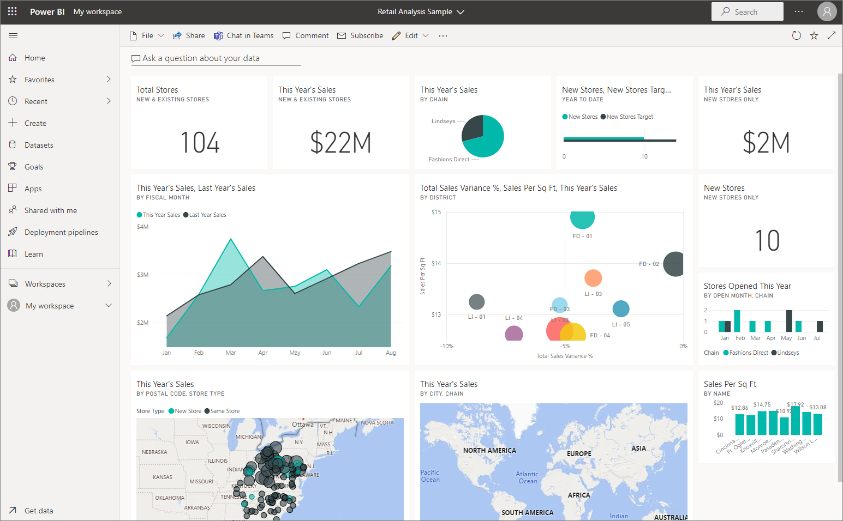
Power BI for Beginners
T. SHAEEN, J. Schellinck | SYSABEE | DATA ACTION LAB P. Boily | UNIVERSITY OF OTTAWA | FACULTY OF SCIENCE | DEPARTMENT OF MATHEMATICS AND STATISTICS IDLEWYLD ANALYTICS | DATA ACTION LAB
S. DAVIES | DAVHILL | DATA ACTION LAB

Slide 3

Instructor – Patrick Boily
Employment
Professor Math/Stat [‘19 – now, uOttawa]
President [‘16 – now, Idlewyld Analytics]
Manager and Senior Consultant [’12 – ‘19, CQADS, Carleton]
Public Service [’08 – ’12, ASFC | StatCan | TC | TPSGC]
60+ uni course; 250+ workshop days
Projects
GAC; NWMO; CATSA; etc.
40+ projects
Specialization
Data visualization; data cleaning (… unfortunately)
Application of wide breadth of techniques to all kinds of data
Mathematical/statistical modeling

Slide 4

Instructor – Tristan Shaeen
Employment/Experience
AI Consultant [‘21 – now, Sysabee, AI Guides]
Instructor [‘21 – now, Data Action Lab]
Projects
Global Affairs Canada
Small and medium enterprises
Labour Market Information Council
Specialization
Statistical training
Data presentation and data storytelling

Slide 5
Course Material
Course Webpage:
https://data-action-lab.com/pbifb
Contact Info:
pboily@uottawa.ca tshaeen@sysabee.com
Data Visualization Course Notes:
https://www.practicedataviz.com
Slack Workspace:
https://dspdi.slack.com

Slide 6
Course Description
Organizations have, and continue to accumulate, masses of data from multiple sources. This data, being largely unformatted, does not yield readily pertinent information. Microsoft tackled this issue by adding data analytics tools to their Microsoft Office 365 suite.
Power BI, the latest addition to Office 365, enables users to aggregate and interpret massive data in a user-friendly environment. With this data visualization tool, analysts build custom data analysis and dashboards with scheduled automated updates: empowering managers’ decision making with accurate and intuitive real-time measures.
This fast-paced introductory course to Microsoft’s Power BI application covers key concepts for delivering effective automated dashboards. This is a hands-on training session: participants learn Power BI’s functionalities as they build an interactive report. Best practices for data visualizations and dashboards are described and applied through examples.

Slide 7
Learning Outcomes
At the end of this course, participants will be able to:
understand the Power BI Solution workflow to properly use the different apps
build an interactive report in Power BI Desktop app
combine multiple data sources and create dynamic data visualizations
*use storytelling tools: bookmarks, spotlight, focus, tooltip, axis hierarchy
explore advanced functionalities to transform and enhance data with Power Query Editor and measures in DAX

Slide 8
Sister Courses
Data SCIENCE ESSENTIALS
Data visualization and Dashboards
INTRODUCTION TO MACHINE LEARNING
Non-Technical Aspects
Data Science Basics
Data Preparation
Data Engineering
Data Viz Concepts
Dashboarding
Storytelling with Data
Data Viz with ggplot2
Statistical Learning
Classification
Clustering
Issues and Challenges

Slide 9
The Set-Up: Borealis Terraformers
Borealis Terraformers LLC is a terraforming company.
It does business, it transacts with consultants, it has employees, it pays them, it delivers products, it records its transactions.
It also has projects (Major Capital MC, Minor Capital MIC, Operations and Management O&M, and Salary SA), and departments.

Slide 10
The Plan: Course Components
Participant Activities (PA): follow along with the instructors.
Instructor Demos (ID): sit back, relax, and take it all in.
Behind the Scenes (BS): a summary of what has been prepared for you.
Dashboard Discussions (DD): let’s talk about the dashboards.
Basic Notions (BN): non-Power BI stuff worth knowing about.
Exercises: take it one step further.

Slide 11
The Plan: Important Documents
We will be exploring Power BI’s functionality by building a 6-page dashboard.
As we want to encourage you to play with the tool without fear that you will break it (or what we have planned), we have prepared 8 Power BI dashboard files (PBIX), at various stages of development, which you can load to re-enter the stream at any moment.
Download PBIfB.zip from the course website, and unzip the file to an easily accessible location on your hard drive, to which you will also download the course datasets.
Step-by-step instructions for the PA and ID tasks are also available.

Slide 12
The Plan: Course Outline
I. Power Query
Load Data (PA)
Transform Data (PA)
II. Preparation
Change Data Types (ID)
Link Fields with Data Models (ID)
Create a Filter (BS)
III. Exploration
Basic Data Visualization Notions (BN)
Load PBIX – 1 (PA)
Make and Format a Bar Chart (PA)
Make and Format a Donut Chart (ID)
Create a Table to Store Measures (ID)
DAX vs. M. vs. GUI (BN)
Create Calculated Measures (ID/PA)
Make and Format a Donut Chart (ID)
Make and Format a Treemap (BS)

Slide 13
The Plan: Course Outline
III. Exploration (cont.)
Create a Calculated Measure (BS)
Load and Explore PBIX – 2 (PA)
Create a Calculated Column (BS)
Format Decimal Places (BS)
Make and Format a Bar Chart (BS)
Make and Format a Line Chart (PA)
Create a Calculated Measure (ID)
Make and Format a Line Chart (ID)
Exploring the Data (DD)
IV. Situational Awareness
Basic Dashboard Notions (BN)
Measures vs. Columns (BN)
Load and Explore PBIX – 3 (PA)
Create a Calculated Column (ID)
Make and Format a Table (BS)
Make and Format a Column Chart (BS)
Load and Explore PBIX – 4 (PA)
Make and Format a Bar Chart (PA)
Make Slicers (PA)
Load and Explore PBIX – 5 (PA)

Slide 14
The Plan: Course Outline
IV. Situational Awareness (cont.)
Make and Format Column Charts (ID)
Load and Explore PBIX – 6 (PA)
Make and Format a Column Chart (PA)
Monitoring the Situation (DD)
V. Storybook
Basic Storytelling With Data Notions (BN)
Create a Calculated Column (ID)
Make and Format Small Multiples (ID)
Make and Format a Bar Chart (ID)
V. Storybook (cont.)
Load and Explore PBIX – 7 (PA)
Apply a Page Filter (PA)
Make and Format a Small Multiples Chart (PA)
Make and Format a Bar Chart (PA)
Annotate a Dashboard (ID)
Load and Explore PBIX – 8 (PA)
Convincing an Audience (DD)
VI. Miscellanea*
*Publish a Power BI Dashboard (BN)
*Integrate R in Power BI (BN)

Slide 15
The Tool: Power BI
Dashboarding tools are, for the most part, story-driven tools: Microsoft’s Power BI is one such tool (download and install the latest version if this has not been done yet).
Its learning curve (reasonably steep, as with all new tools) is attenuated somewhat by its distinctly “Microsoft-ish” point-and-click functionality.
It allows dashboards to be easily published and distributed on the web (either internally and/or externally).
But it does not play nicely with MacOS and Linux (there are workarounds).

Slide 16
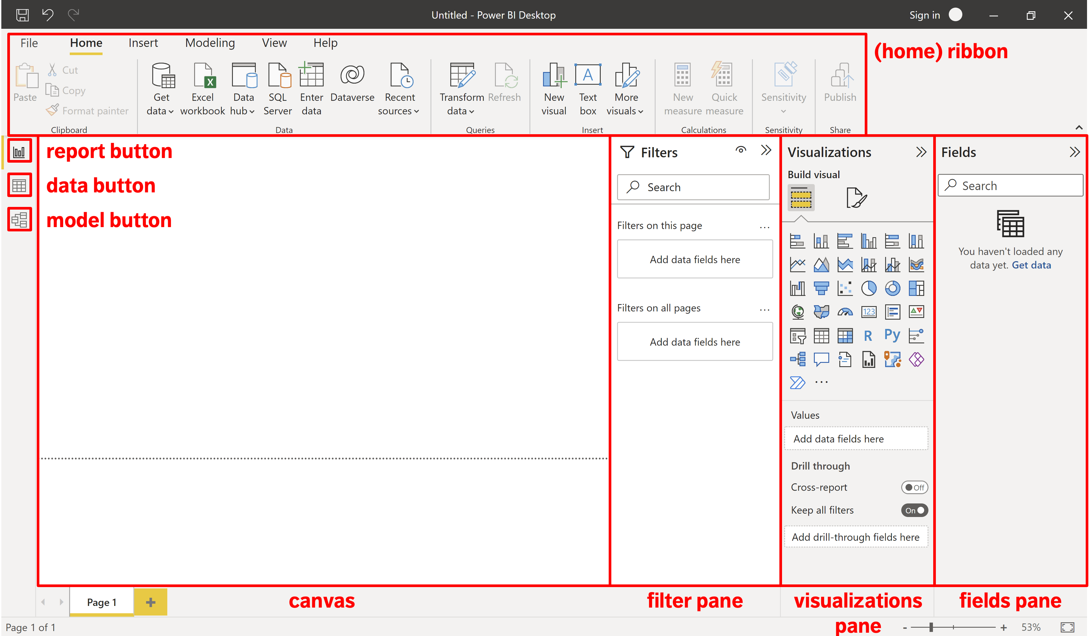

Slide 17
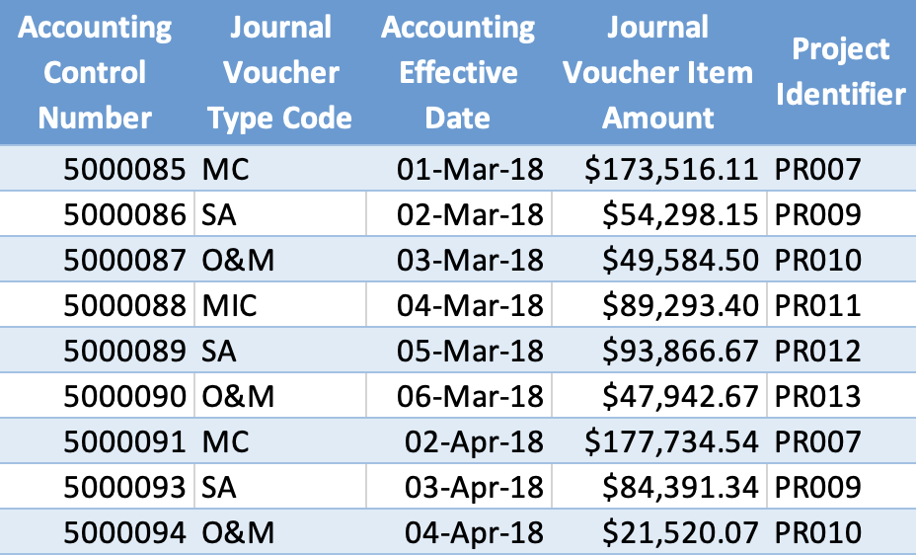
The Data: Borealis Terraformers
Let’s take a look at one dataset that we are going to use:
Data Set - Accounting.xlsx
Download it to your hard drive (you may need to rename the file).
Tab – Journal Voucher Type Code
Tab – Accounting Transactions

Slide 18
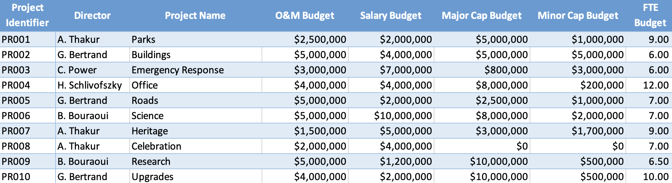
The Data: Borealis Terraformers
Let’s take a look at another dataset that we are going to use:
Data Set - Projects.xlsx
Download this one to your hard drive too, in the same location (you may also need to rename the file).
Tab – Project Tombstone
Tab – Project FTE Count

Slide 20
I. Power Query
POWER BI FOR BEGINNERS

Slide 21
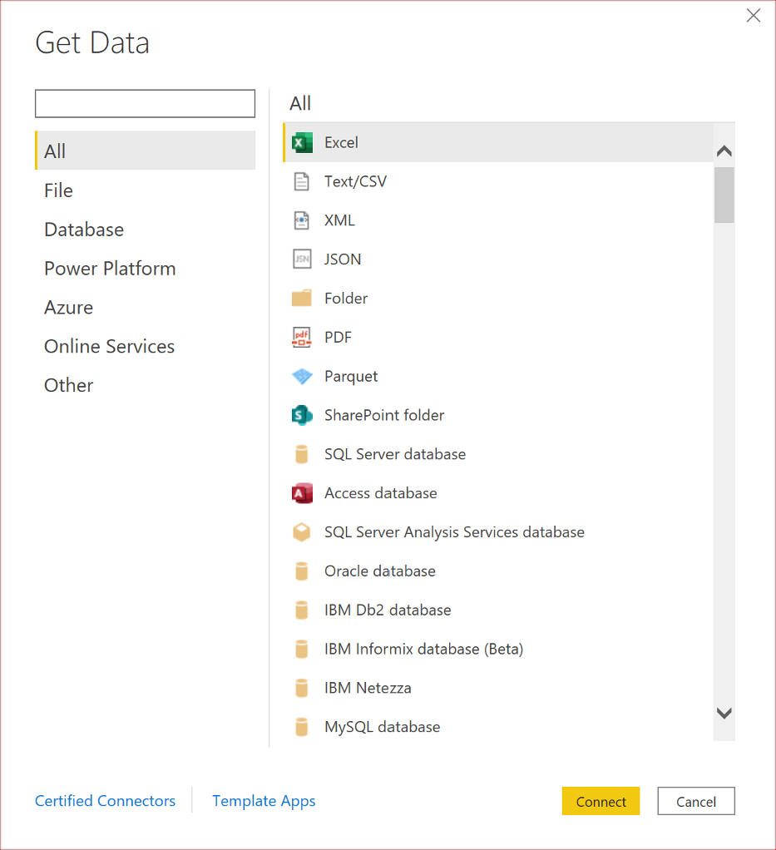
1. Load Data (PA)
We might want to “tweak” the data before loading it into Power BI. We can accomplish this using the Power Query Interface (see detailed instructions, p. 1).
Open Power BI.
Close the yellow “Hello” screen.
In the “Home” ribbon at the top of the Power BI screen, there is a clickable region named “Get Data” – activate it to bring up several data format options.
Among all the options, select “Excel”.
Click on Data Set - Accounting.xlsx, and select “Open”.

Slide 22
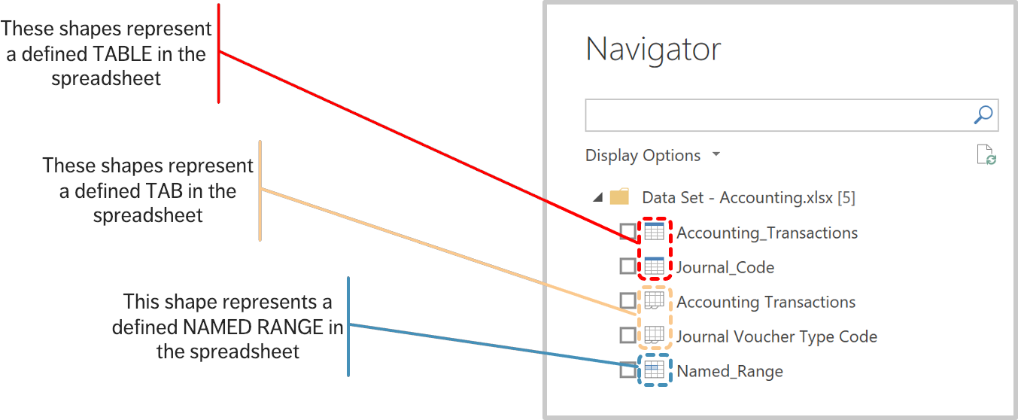
1. Load Data (PA)

Slide 23
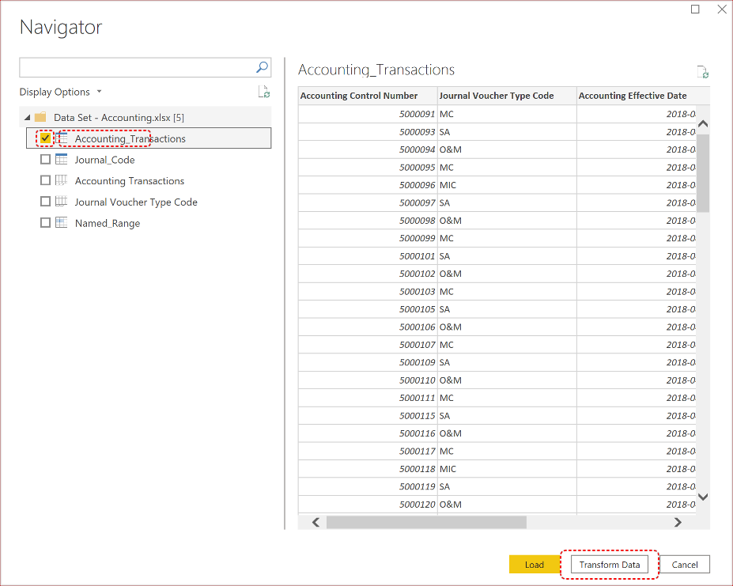
2. Transform Data (PA)
We do not need to transform data at the source.
Click on the first TABLE (the one named “Accounting_Transactions”) without selecting the checkbox (yet) – this brings up a display of the table (clicking on the other options will bring up their displays);
Select the “Acounting_Transactions” checkbox (don’t click on “Load” yet!);
We want to tweak the data before loading it, so we edit the transformation by clicking on “Transform Data”.

Slide 24
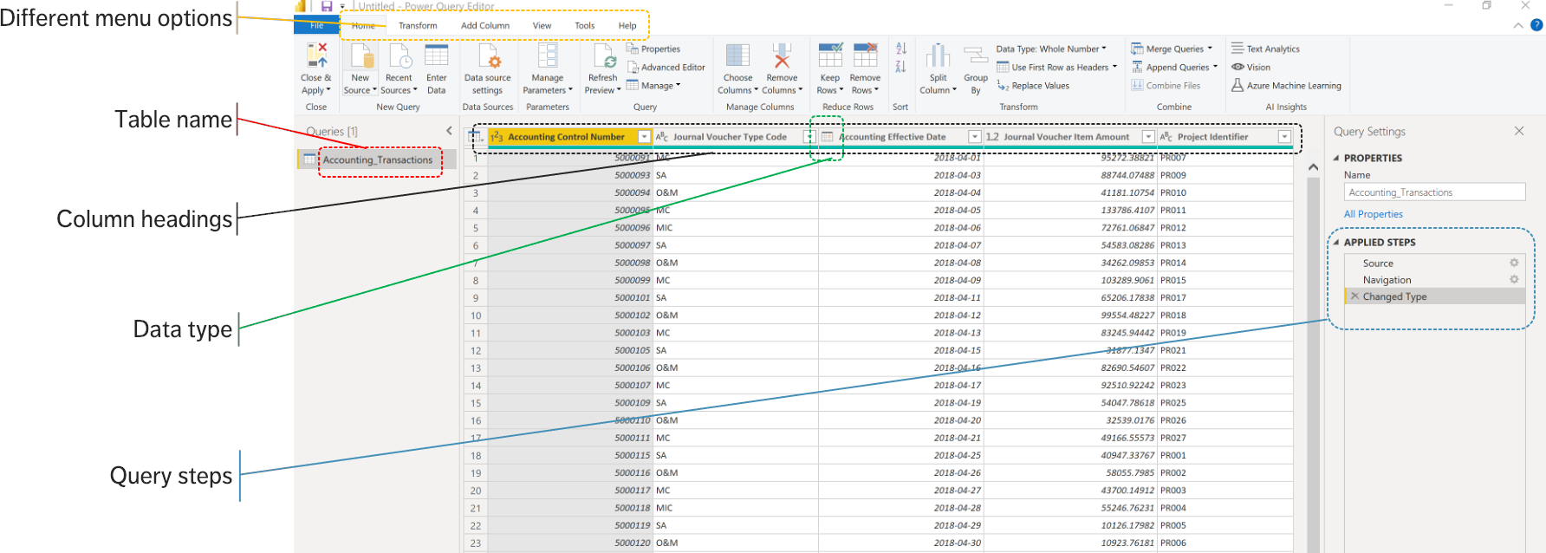
2. Transform Data (PA)

Slide 25
2. Transform Data (PA)
We proceed with the following steps to transform the data (see detailed instructions, p. 1):
change the name of the table;
change the name of the “Accounting Effective Date” column to “Effective Date” and “Journal Voucher Item Amount” to “Item Amount”;
remove the dates from March 2018 in the “Effective Date” column;
close and apply the transformation;
save the PBIX file;
retrieve the "Project_Tombstone" table from “Data Set – Projects.xlsx”.

Slide 26
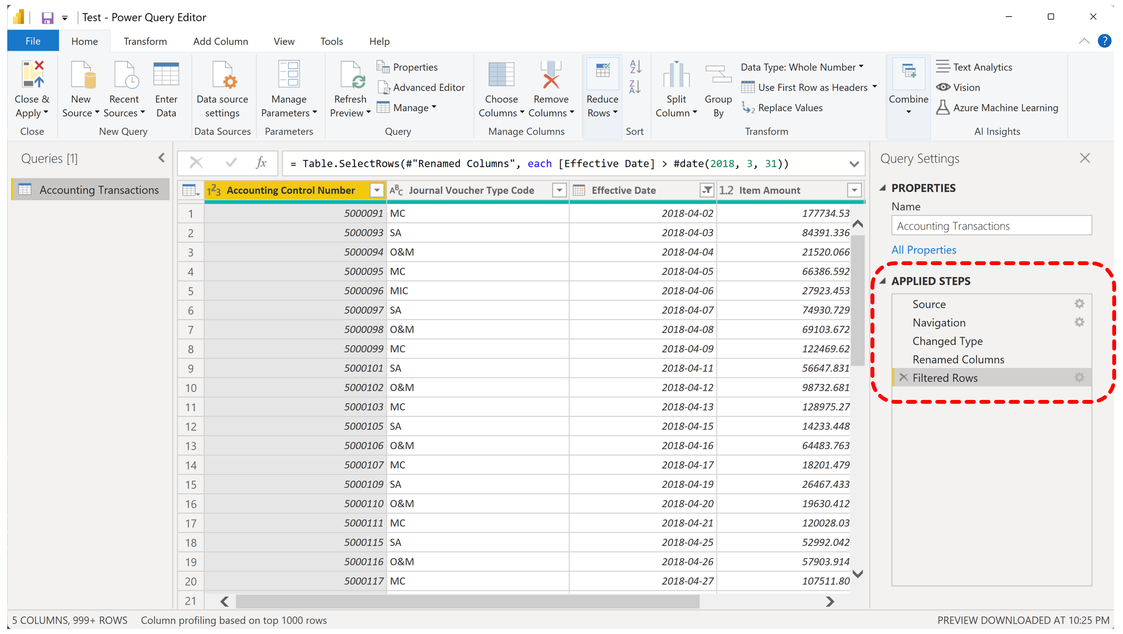
2. Transform Data (PA)

Slide 27
II. Preparation
POWER BI FOR BEGINNERS

Slide 28
3. Change Data Types (ID)
We proceed with the following steps (see the detailed instructions document):
go to the “Fields” pane and drop down on “Accounting Transactions”;
after clicking on “Item Amount” you will see that new options appear in the top Ribbon, namely, “Column Tools”;
this is where we go to change the data type for “Item Amount” from a decimal value to a currency; we also change “Effective Date” into a short date.
(see detailed instructions, p. 1)

Slide 29
4. Link Fields with the Data Model (ID)
In the Model, the two tables are linked by the “Project Identifier” variable.
How did this happen?
We enter the “Data Model” view and remove the link. Now the two tables are unlinked, meaning that they cannot “talk” to one another.
Here is how we would link them (see detailed instructions, p. 1).

Slide 30
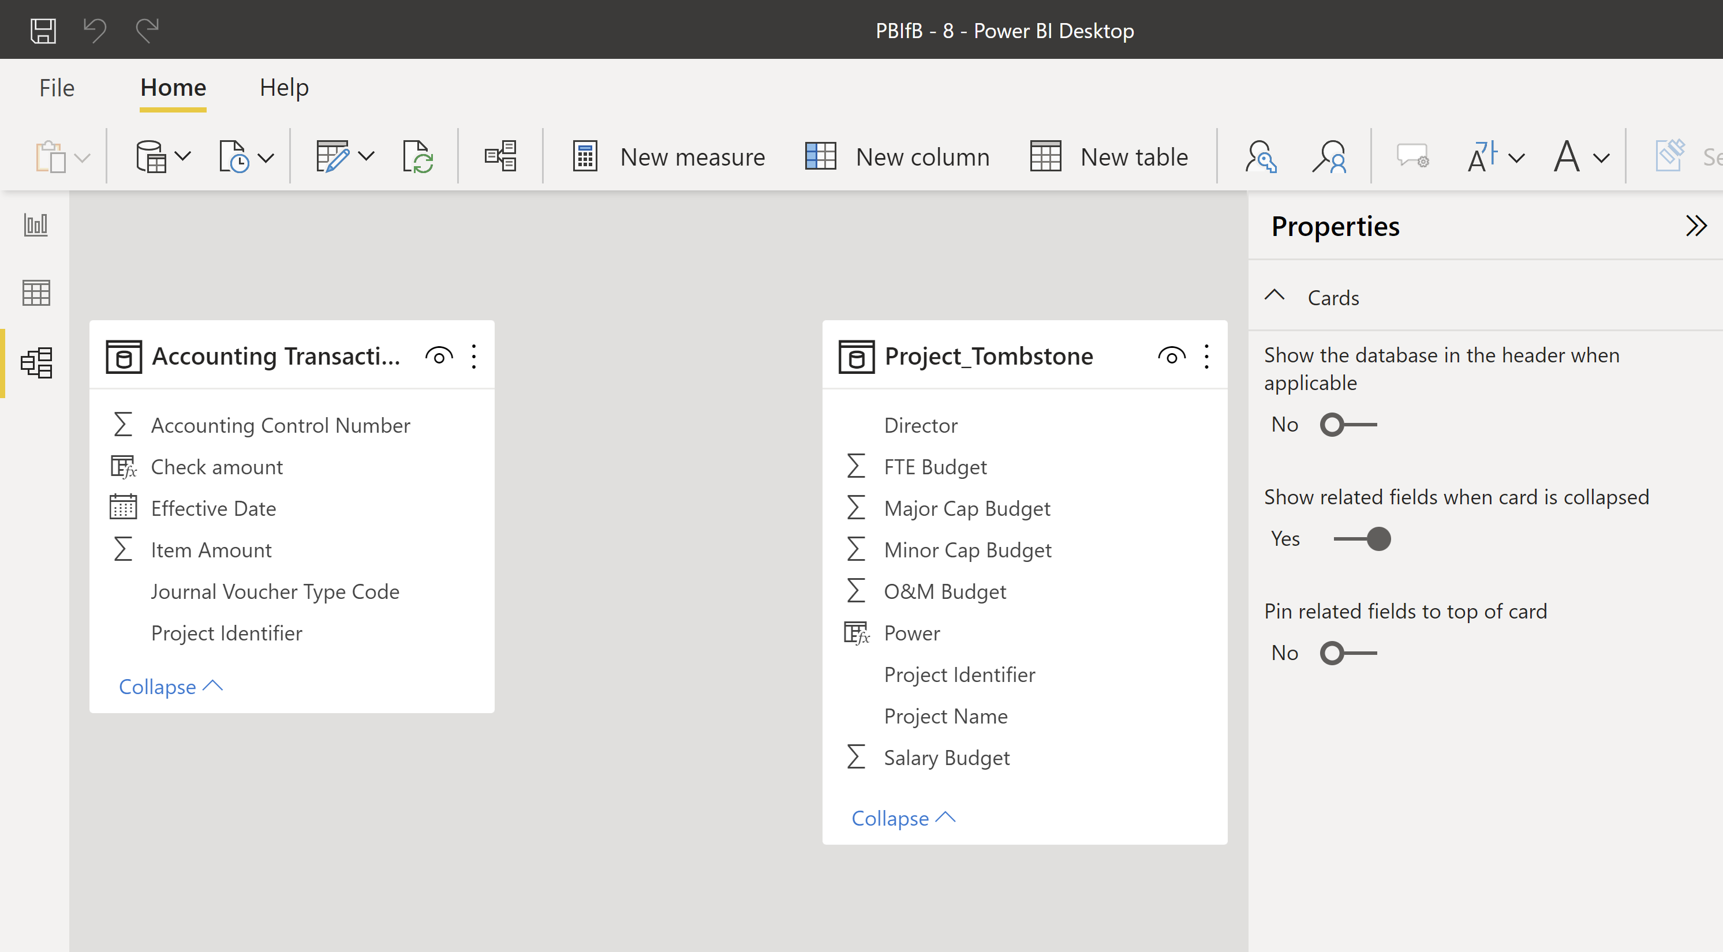
4. Link Fields with the Data Model (ID)
???

Slide 31
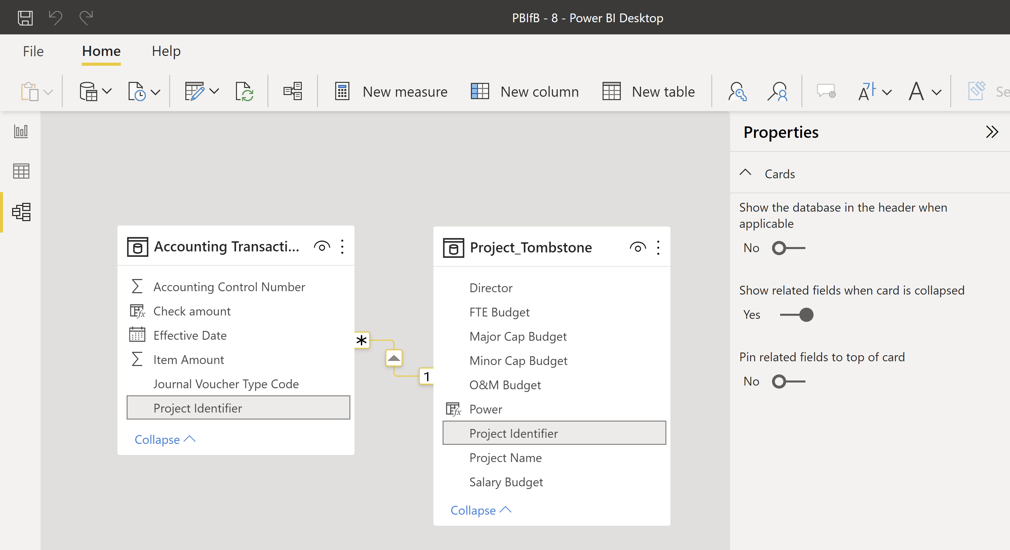
4. Link Fields with the Data Model (ID)

Slide 32
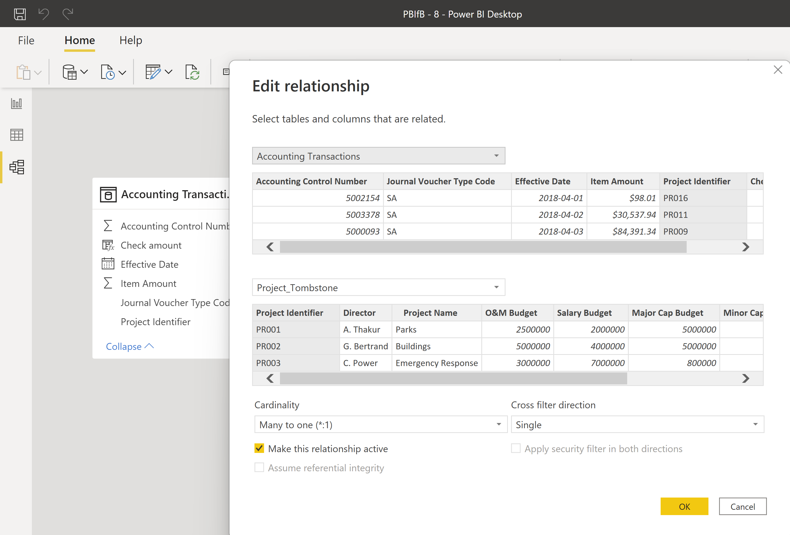
4. Link Fields with the Data Model (ID)

Slide 33
5. Create a Filter (BS)
For the first part of this dashboard (Exploration 1, Exploration 2), we only use the data from 2018.
We create a page filter by setting the “Effective Date” to 2018.

Slide 34
III. Data Exploration
POWER BI FOR BEGINNERS

Slide 35
6. Pre-Analysis Use (BN)
Data visualization can be used to set the stage for analysis:
detecting anomalous entries invalid entries, missing values, outliers
shaping the data transformations binning, standardization, Box-Cox transformations, PCA-like transformations
getting a sense for the data data analysis as an art form, exploratory analysis
identifying hidden data structure clustering, associations, patterns informing the next stage of analysis

Slide 36
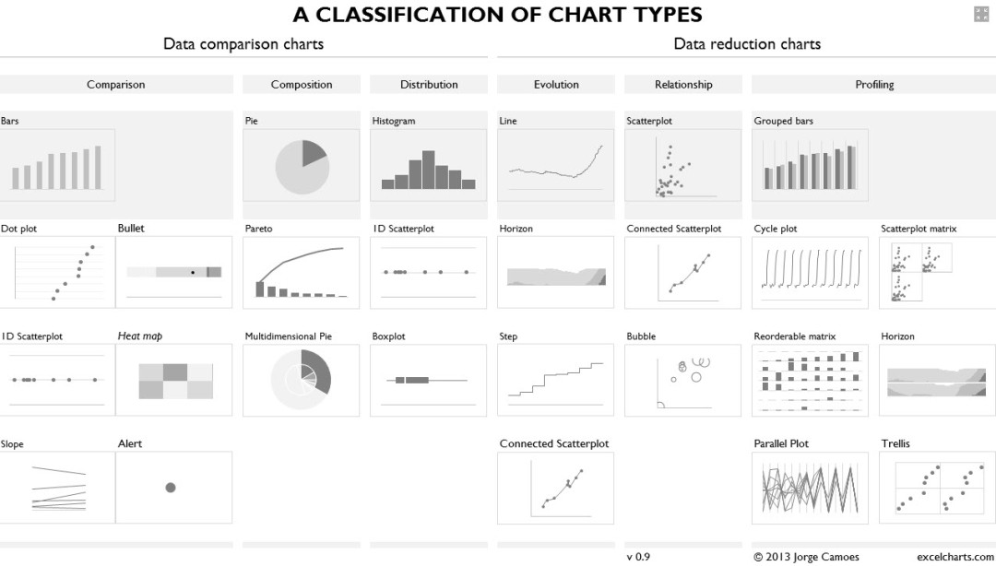
Basic Notions
Data Visualization

Slide 37
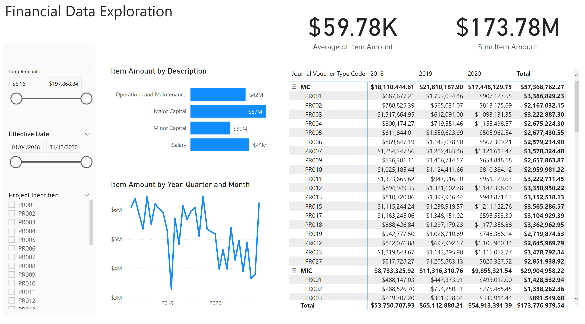
6. Exploration and Visualization (BN)
Using visualizations as a tool to explore/understand the data
high level of interactivity
high level of detail
all aspects of data should be represented (tables, columns, calculations etc.)
no annotations or explanations required
POWER BI FOR BEGINNERS

Slide 38
7. Load a PBIX File (PA)
Load and explore PBIFB – 1.pbix (tasks 1-5).
Go to “Transform Data” in the “Home” Ribbon.
Click on “Data Source Settings”.
Highlight one of the data files.
Click on “Change Source”.
Click on “Browse” and navigate to the corresponding file’s location on your system.
Repeat for the other file.
Press “Close”.
Apply changes from the yellow warning message.

Slide 39
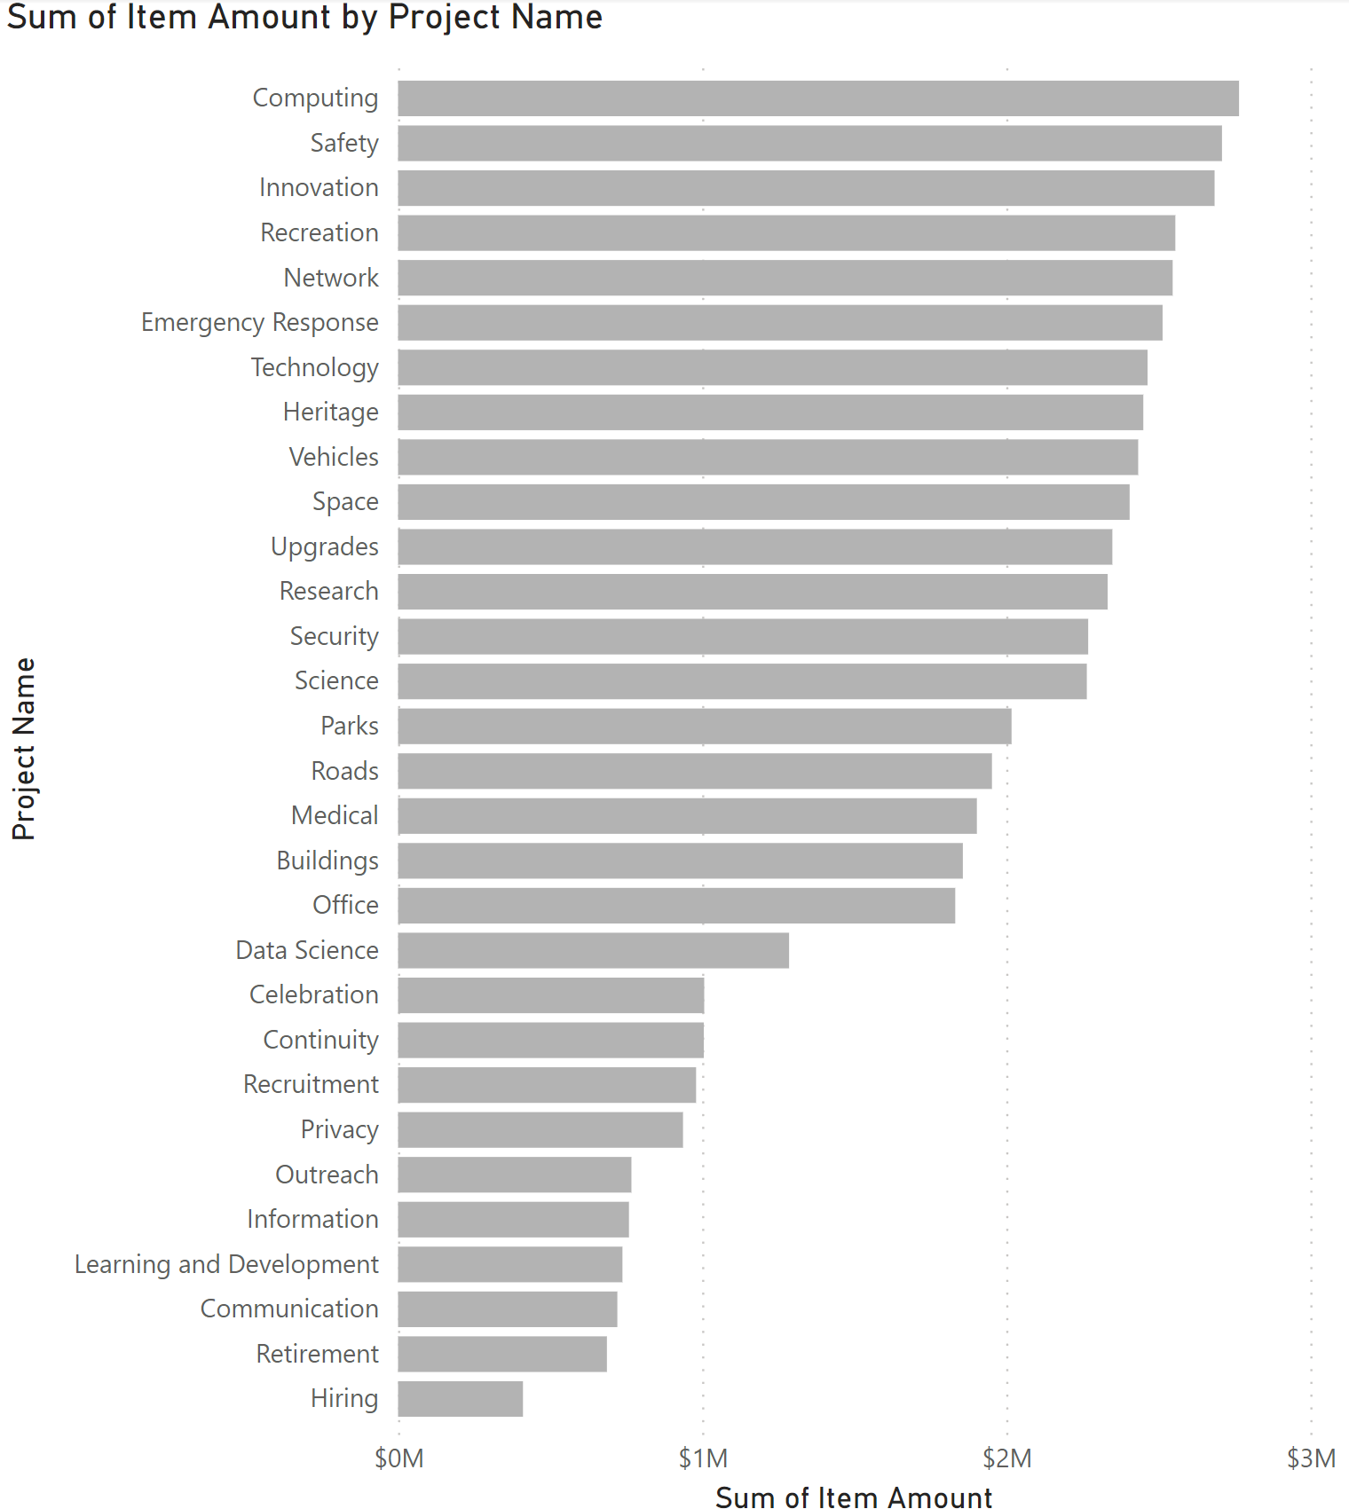
8. Make and Format a Bar Chart (PA)
We make a bar chart displaying the sum of “Item Amount” for all 2018 project entries, by “Project Name”.
We also format the chart to have grey bars.
(see detailed instructions, p. 2)
POWER BI FOR BEGINNERS

Slide 40
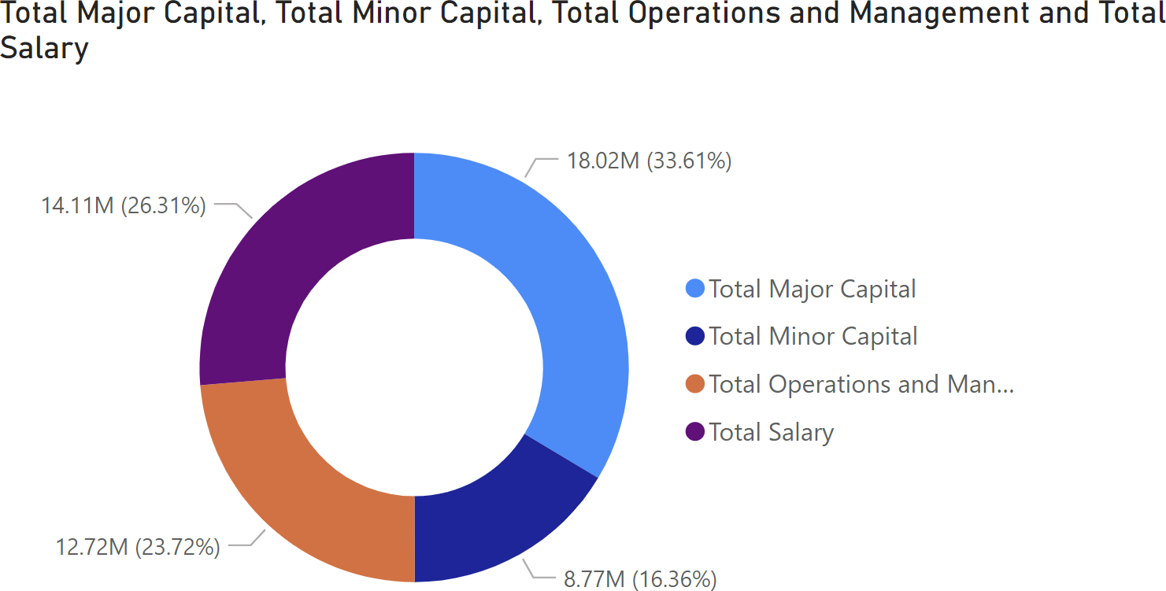
9. Make and Format a Donut Chart (ID)
We can create other types of charts, such as a donut chart.
(see detailed instructions document, p. 2)
We will revisit this chart when we talk about measures.
POWER BI FOR BEGINNERS

Slide 41
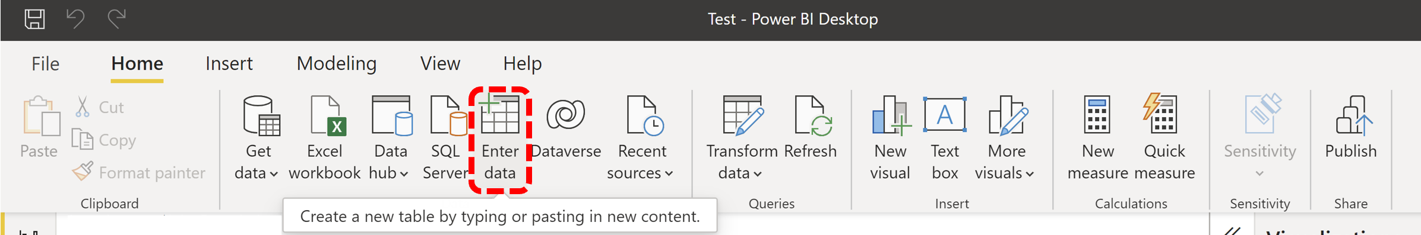
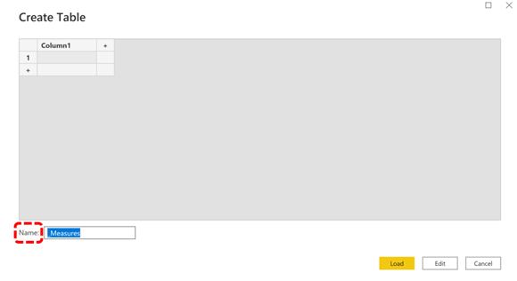
10. Create a Table to Store Measures (ID)
Before we build a first measure, we create a “_Measure” table in which the measures can reside.
(see detailed instructions, p. 2)

Slide 42
11. DAX vs. M vs. GUI (BN)
Power BI is really two products:
data is imported through Power Query, which is used to manipulate/transform the data
when ready, Power Query “pushes” the data into Power BI, for visualization and manipulations
Power Query uses the language “M” in the background; Power BI uses “DAX”.
Basic charts are created using the Power BI Graphic User Interface (GUI); for more complicated/sophisticated things, we need to use M and/or DAX.

Slide 43
11. DAX vs. M vs. GUI (BN)
What is M?
M is the data transformation engine in Power BI (prior to loading data into the model)
M contains commands to transform data and to return the results of the query and trans-formations to the Power BI data model
normally, we use M Query to query data sources, clean, and load data
instead of bringing 3 tables into Power BI, say, we can remove unneeded columns and merge the tables into a single table to load into the model (this reduces load and improves performance, which is crucial for larger datasets)

Slide 44
11. DAX vs. M vs. GUI (BN)
What is the Data Analysis eXpression (DAX) language?
DAX is the common language used by SQL Server Analysis Services Tabular, Power BI, and Power Pivot in Excel
DAX is the analytical engine in Power BI
it is used once the data is loaded to create custom columns and tables (data) or measures (functions)
it has some similarities to Excel functions, but much more powerful in general

Slide 45
12. Create Calculated Measures (ID/PA)
Measures are introduced when we want to focus on a column’s categories.
For instance, we might want to create charts that focus on the various “Item Amount” categories :
Total Major Capital
Total Minor Capital
Total Operations and Management
Total Salary
(see detailed instructions, pp. 2-3)

Slide 46
13. Make and Format a Donut Chart (ID)
We can now achieve the same donut chart as we had obtained when dragging “Journal Voucher Type Code” onto the “Legend” field.
The difference is that we can now re-order the categories as needed and use them for new measures/columns (see detailed instructions, p. 3).
POWER BI FOR BEGINNERS

Slide 47
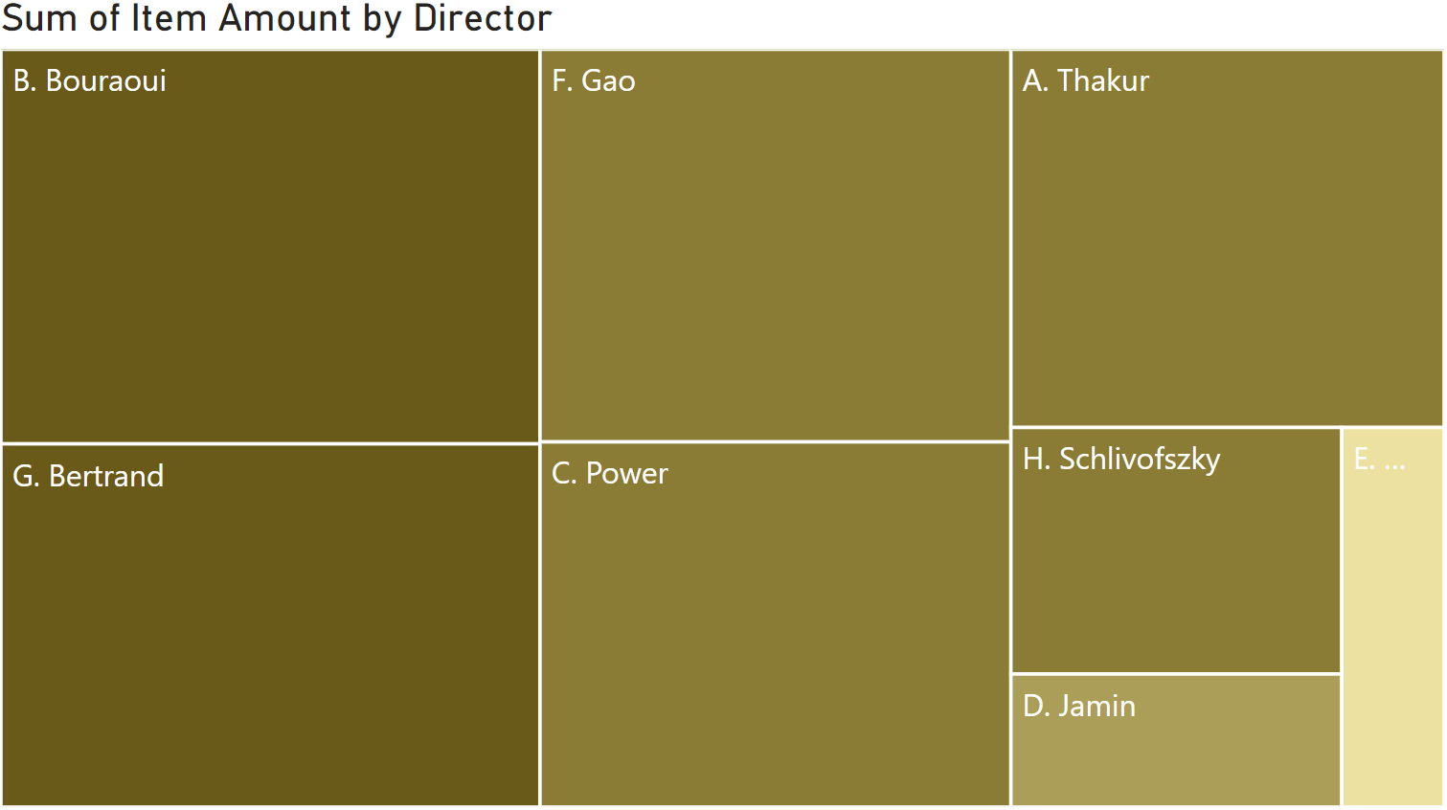
14. Make and Format a Treemap Chart (BS)
We can play around with the charts to get a better understanding of the data.
For instance, we could create a treemap showing the sum of “Item Amount” transactions by director.

Slide 48
15. Create a Calculated Measure (BS)
It could also be handy to have a way to report the large transaction values as multiple of 1000$.
We created a calculated measure that does so: “Item Amount $k Measure”.
We will discuss measures further in a little while.
We create a new page for the dashboard, called “Evaluation 2”, and we place a page filter on it to ensure that we are only using 2018 transactions.

Slide 49
16. Load a PBIX File (PA)
Load and explore PBIFB – 2.pbix (tasks 1-5, 8-10, 12-15).
Go to “Transform Data” in the “Home” Ribbon.
Click on “Data Source Settings”.
Highlight one of the data files.
Click on “Change Source”.
Click on “Browse” and navigate to the corresponding file’s location on your system.
Repeat for the other file.
Press “Close”.
Apply changes from the yellow warning message.

Slide 50
17. Create a Calculated Column (BS)
We can also act on the entire column to create a new column: we will do so with the same intent as the previous measure, “Item Amount $k”.
Note that:
“Item Amount $k Measure” is a measure residing in the “_Measures” table
“Item Amount $k” is a column residing in the “Accounting Transactions” table
While they ostensibly relate to the same idea (and are both calculated using DAX formulas), they are emphatically different Power BI entities (more on this later).

Slide 51
18. Format Decimal Places (BS)
Power BI can format the data once it enters the model.
For instance, we can format the original “Item Amount” column and the calculated column “Item Amount $k” (from the “Accounting Transactions” table) so that they are displayed with 2 decimal places.

Slide 52
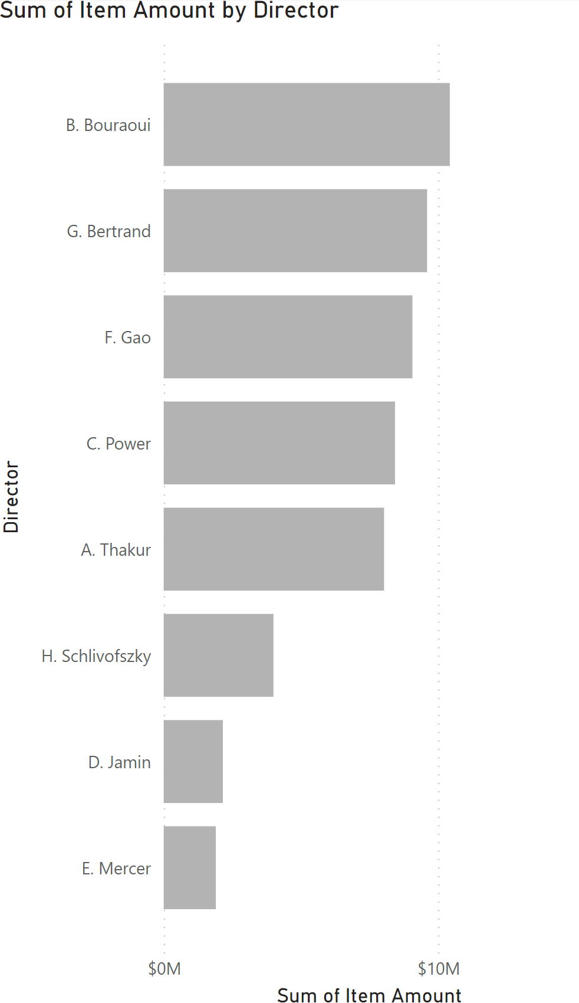

19. Make and Format a Bar Chart (BS)
We create a bar chart showing the sum of “Item Amount $k” for each director.
This is equivalent to the treemap chart of task 14 (except that the amounts are in 1000$ of dollars).

Slide 53
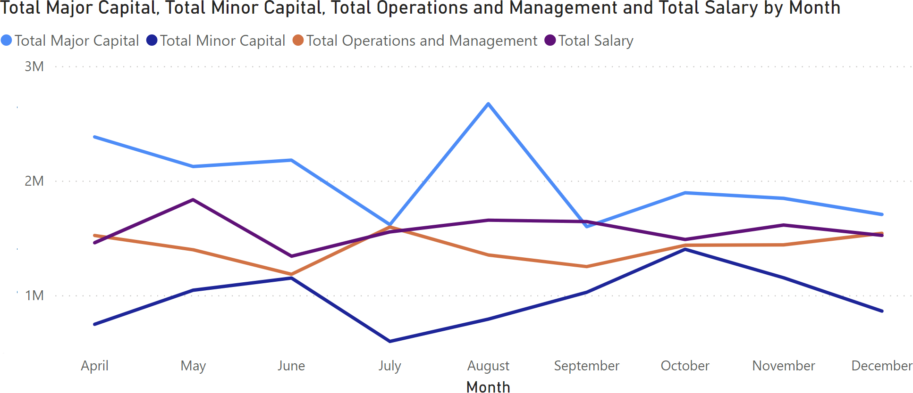
20. Make and Format a Line Chart (PA)
For some variables (dates, geography), we can create hierarchies.
We use such hierarchies to create a line chart (see detailed instructions, p. 3).
Take some time to play around with the hierarchies to drill down and up with the time series graph to become familiar with the concept.

Slide 54
21. Create a Calculated Measure (ID)
There is a spike in the previous chart that seems like it would be worth exploring in more detail.
To do so, we create a calculated measure (built from two measures), the ratio of “Total Major Capital” to “Total Minor Capital”, denoted “Major Minor Ratio” (see detailed instructions, p. 3).

Slide 55
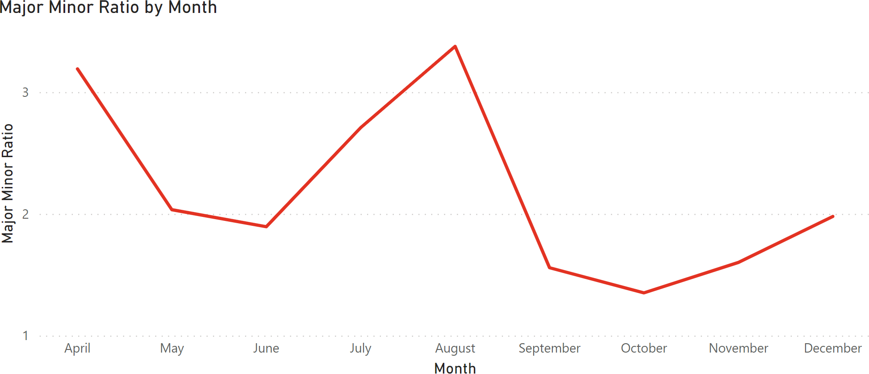
22. Make and Format a Line Chart (ID)
We create a new line chart displaying the “Major Minor Ratio” by Month, using the “Effective Date” hierarchy (see detailed instructions, p. 3).
This “sombrero” shape is unexpected… might it be worth monitoring the situation further?

Slide 56
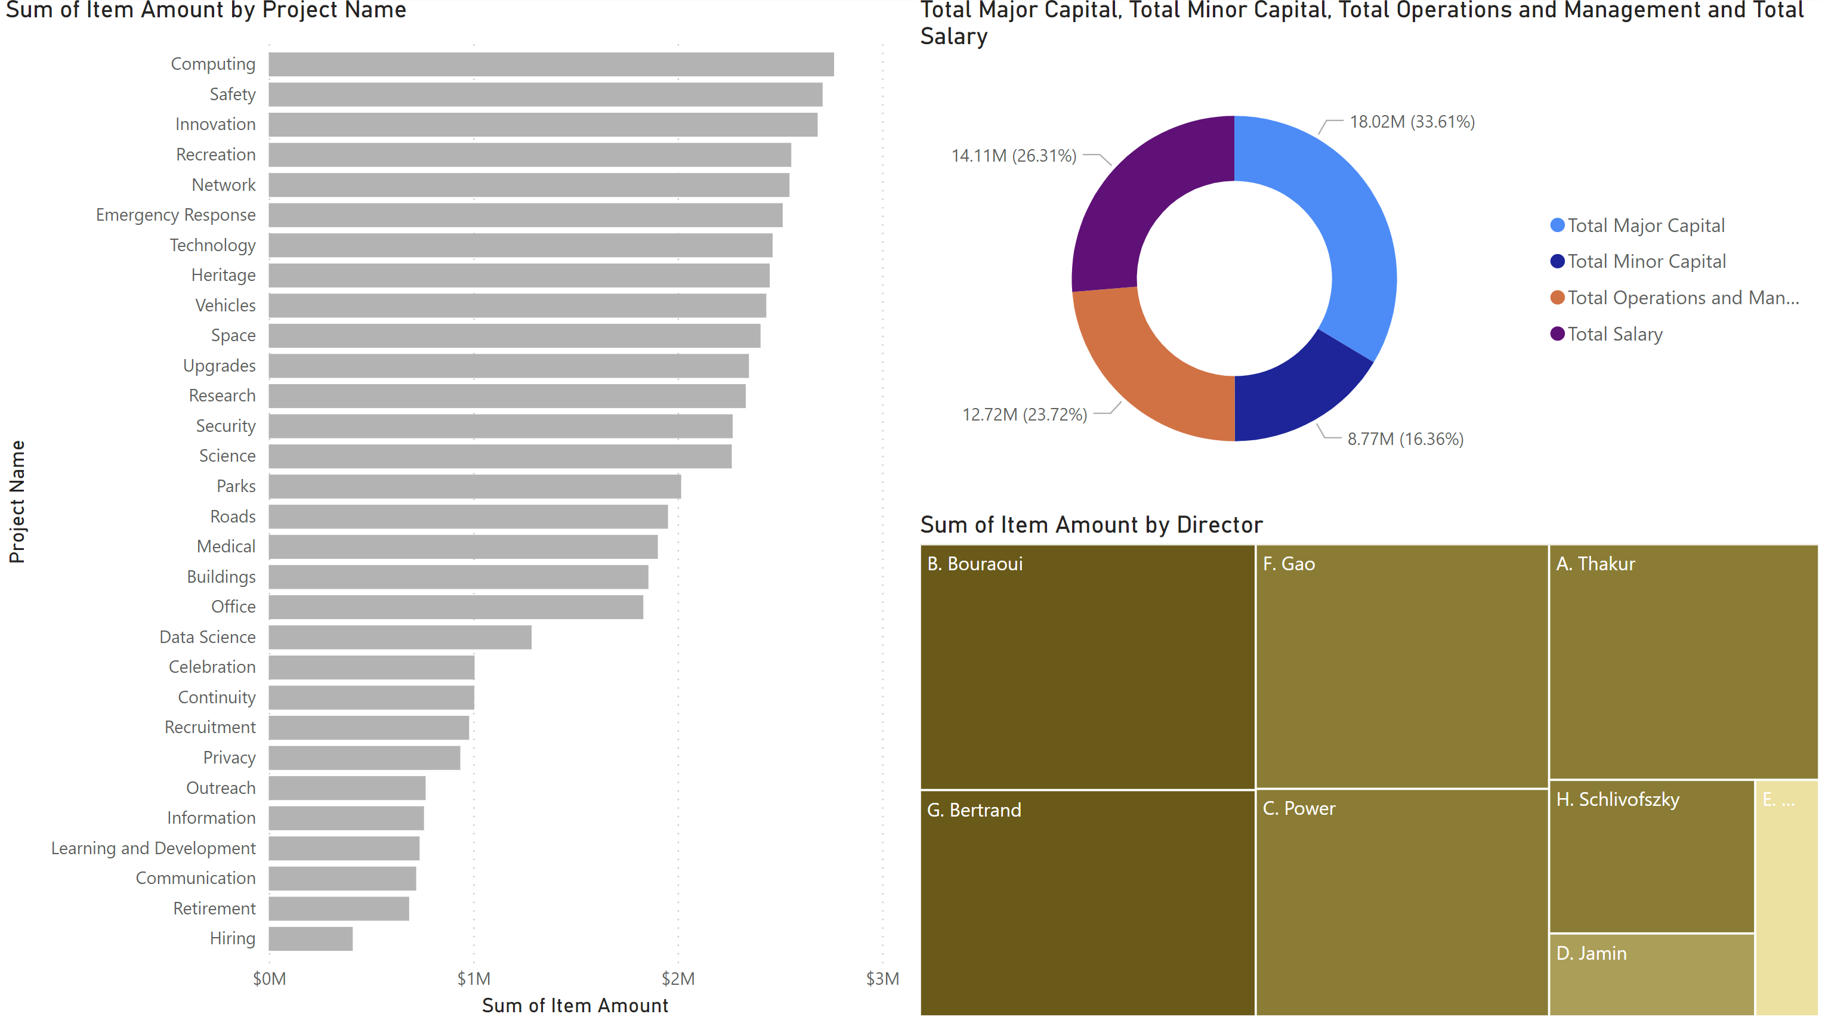
23. Exploring the Data (DD)

Slide 57
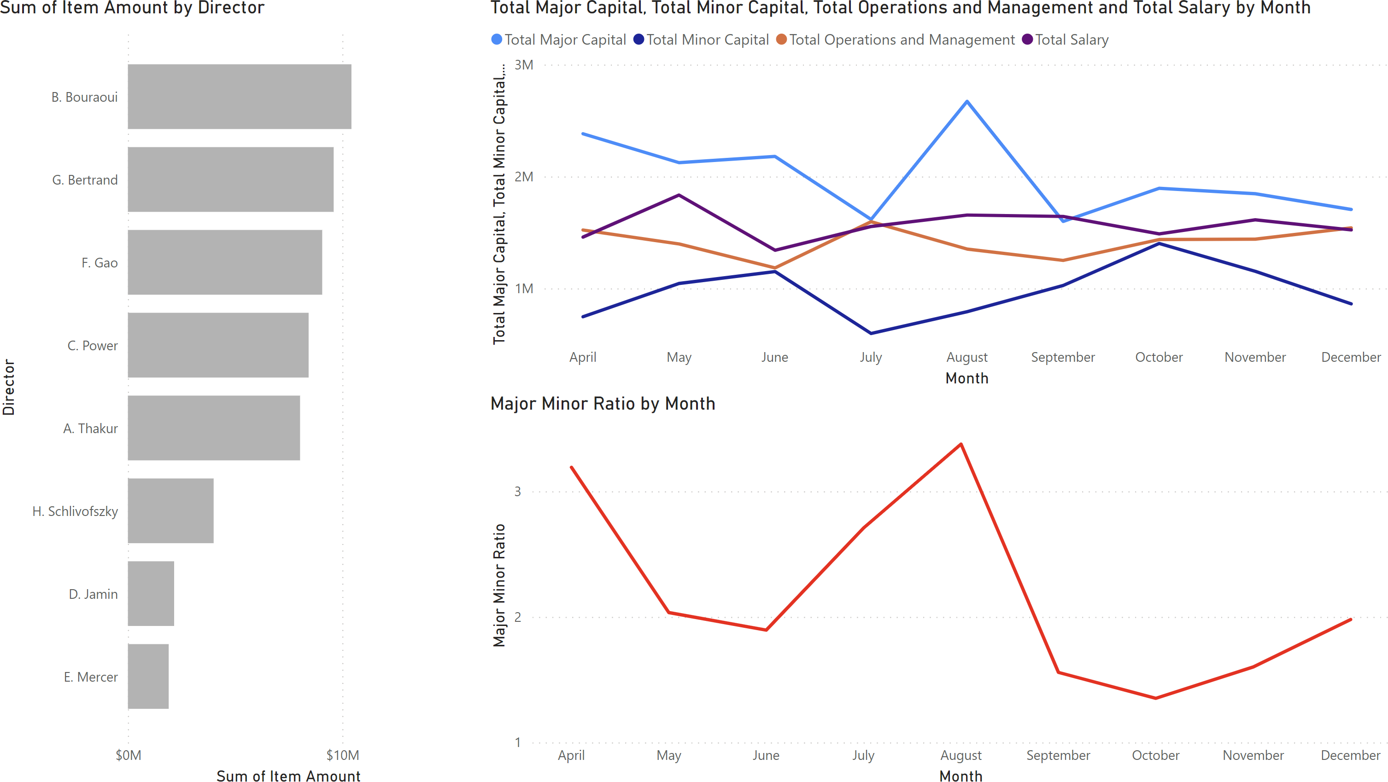
23. Exploring the Data (DD)

Slide 58
Exercises
Continue exploring the dashboard. Can you find anything interesting in the data?
Make and format the donut chart of task 13 using measures.
Make and format the treemap chart of task 14.
Create the calculated measure of task 15.
Create the calculated column of task 17.
Format to decimal places as in task 18.
Create new charts to help you explore the 2018 data.
Data Exploration
POWER BI FOR BEGINNERS

Slide 59
IV. Situational Awareness
POWER BI FOR BEGINNERS

Slide 60
24. Dashboards (BN)
[Wexler, Shaffer, Cotgreave, The Big Book of Dashboards]
A dashboard is any visual display of data used to monitor conditions and/or facilitate understanding.
Examples:
interactive display that allows people to explore motor insurance claims by city, province, driver age, etc.
PDF showing key audit metrics that gets e-mailed to a Department’s DG on a weekly basis.
wall-mounted screen that shows call centre statistics in real-time.
mobile app that allow hospital administrators to review wait times on an hourly- and daily-basis for the current year and the previous year.

Slide 61
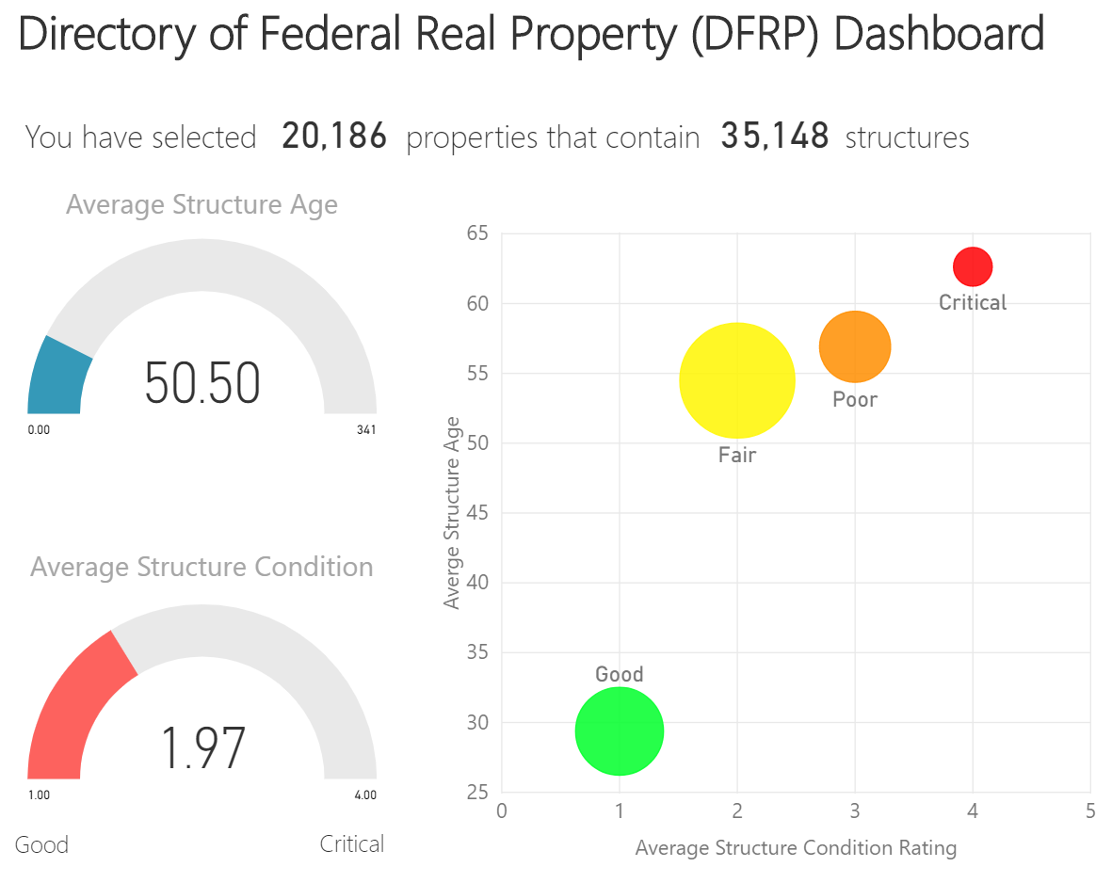
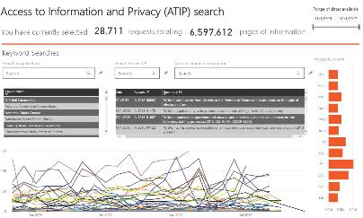
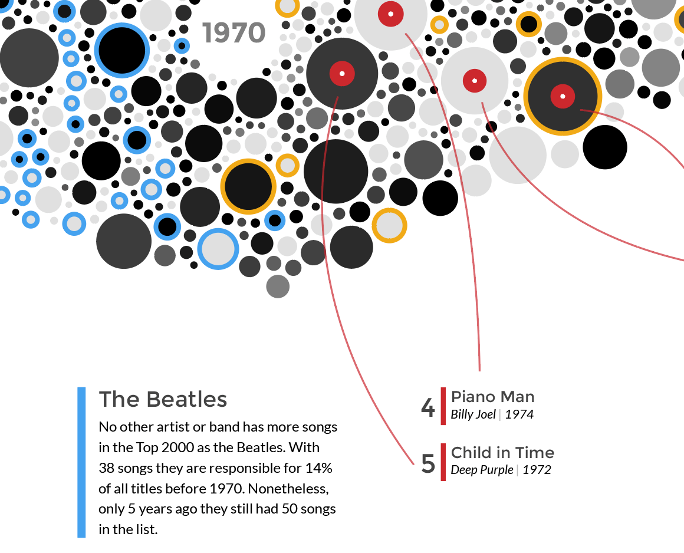
24. Defining Context (BN)
Seconds
Minutes
Fraction of Hour
Hours
Infographics/Data Viz
Dashboards
Reports and Exploration
Data Art

Slide 62
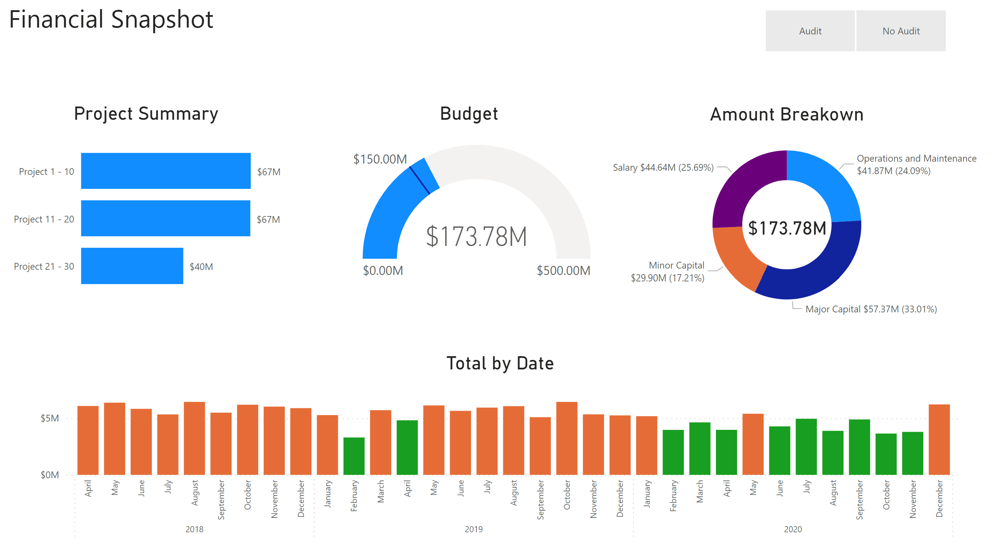
24. Situational Awareness (BN)
Using visualizations as a tool to provide a snapshot of the data
medium level of interactivity
not “scripted” but well organized (e.g., categorized)
summary data should be represented
anomalies are highlighted
often used for internal presentations
POWER BI FOR BEGINNERS

Slide 63
25. Measures vs. Columns (BN)
In Excel, we add a calculation to a cell. In Power BI a calculation can “live” in one of three places (not including in Power Query – more on that in another course). We can do calculations that create:
a new column of data (a calculated column)
a new data value calculated solely to be used in a visualization (a calculated measure)
a new data table (a calculated table).

Slide 64
25. Measures vs. Columns (BN)
Calculated Columns are:
additional data columns added to an existing data table
evaluated for each row in the table, immediately after “Enter” is hit to complete the formula.
saved back into the model, therefore they take up space (with 1M data rows, a calculated column adds 1M new data points).
Calculated Measures are:
evaluated only when used in a visual or when the visual is rendered (function)
not “saved” anywhere (aside from the cache)
preferred to calculated columns, but there are trade-offs with performance (report runtime vs. pre-processed), storage space, and the type of expressions that can be used.

Slide 65
25. Measures vs. Columns (BN)
When do we use calculated columns over measures? Sometimes either is an option, but in most situations the computation needs determine the choice.
A calculated column is used to do the following:
place the calculated results in a slicer, or in the axis of a chart, or use the result as a filter condition in a DAX query;
define an expression that is strictly bound to the current row (for example, “Cost * Volume” does not work on an average or on a sum of two or more columns);
categorize text or numbers (for example, a range of values for a measure, a range of customer ages, such as 0–18, 18–25, etc.).

Slide 66
25. Measures vs. Columns (BN)
Typically, measures is used whenever a resulting calculation needs to be displayed in the values area in the plot area of a chart:
for instance, in calculating the cost percentage on a certain selection of data;
they can use data from many different tables and therefore don’t “belong” to a table in the same way a calculated column is;
it is good practice to create a separate “home” for our measures (“_Measures”).

Slide 67
25. Measures vs. Columns (BN)
Total Amount = sum('Accounting Transactions'[Item Amount])
the measure’s name is “Total Amount”.
the operator “=” indicates the beginning of the formula; when calculated, it returns a result
the function (in this case “sum”) contains one argument, contained in the parentheses “( )”
the table from which we are taking the data is found before the brackets “[ ]”; in this case it is 'Accounting Transactions’.
note that as the table name contains two words, it placed inside single quotations ‘ ’. If the table name only had one word, it would not, i.e. Accounting_Transactions[Item Amount]
the referenced column from the table is placed inside the “[ ]”; such as [Item Amount]

Slide 68
26. Load a PBIX File (PA)
Load and explore PBIFB – 3.pbix (tasks 1-5, 8-10, 12-15, 17-22).
Go to “Transform Data” in the “Home” Ribbon.
Click on “Data Source Settings”.
Highlight one of the data files.
Click on “Change Source”.
Click on “Browse” and navigate to the corresponding file’s location on your system.
Repeat for the other file.
Press “Close”.
Apply changes from the yellow warning message.

Slide 69
27. Create a Calculated Column (ID)
We can use DAX to apply logical operations.
Take a simple scenario in which we flag any transactions for which “Item Amount” is over $100,000. We create a calculated column as follows:
if the “Item Amount” is equal to or greater then $100,000, then we add the word “Check”
otherwise, we leave the value in the new column (blank)
(see the detailed instructions, p. 4)
Note that there is no filter on Effective Date year from this point on.

Slide 70
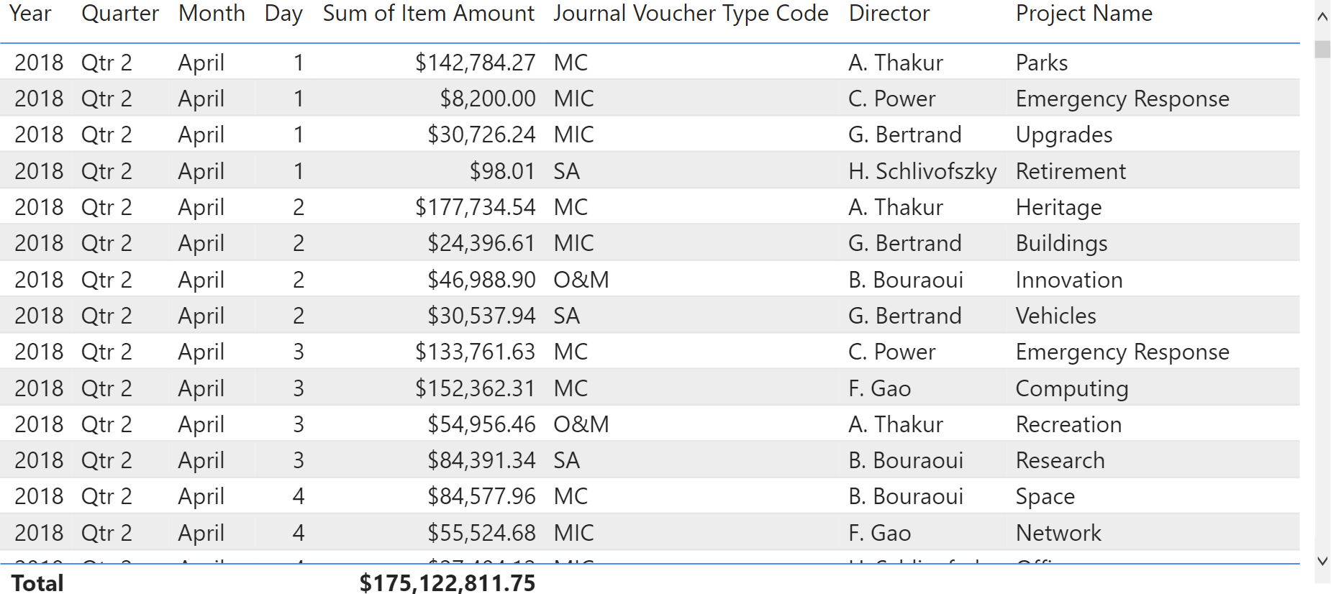
28. Make and Format a Table (BS)
Visuals can also include tables.

Slide 71
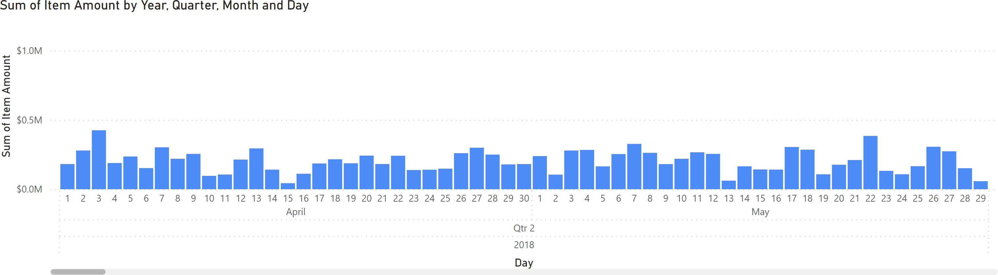
29. Make and Format a Column Chart (BS)
There are enough transactions in the dataset to produce a daily bar chart time series (note the necessary scroller).

Slide 72
30. Load a PBIX File (PA)
Load and explore PBIFB – 4.pbix (tasks 1-5, 8-10, 12-15, 17-22, 27-29).
Go to “Transform Data” in the “Home” Ribbon.
Click on “Data Source Settings”.
Highlight one of the data files.
Click on “Change Source”.
Click on “Browse” and navigate to the corresponding file’s location on your system.
Repeat for the other file.
Press “Close”.
Apply changes from the yellow warning message.

Slide 73
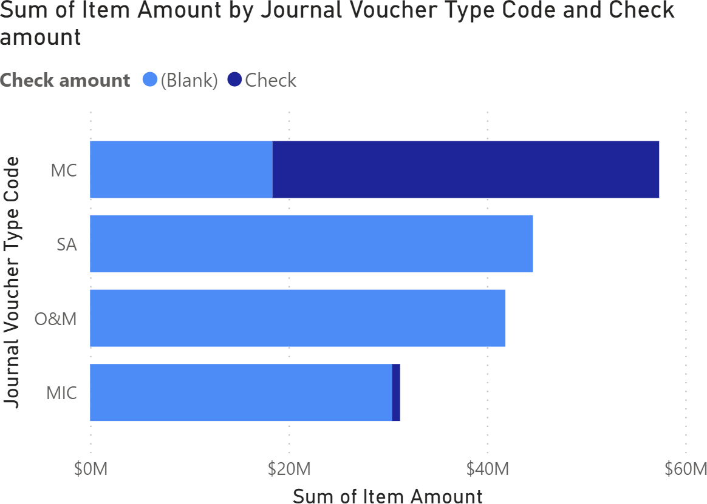
31. Make and Format a Bar Chart (PA)
We create a bar chart that uses the “Check amount” calculated column, for the various JVTC (see detailed instructions, p. 4).
Do you notice anything surprising?

Slide 74

32. Make Slicers (PA)
We create a “Director” slicer and a “Journal Voucher Type Code” slicer for the “Monitoring 2” page (see detailed instructions, p. 4).
The “Check amount” irregularity from the previous bar chart suggests that it could be useful to monitor transactions in the Minor Capital (MIC) regime (especially for director C. Power).

Slide 75
33. Load a PBIX File (PA)
Load and explore PBIFB – 5.pbix (tasks 1-5, 8-10, 12-15, 17-22, 27-29, 31-32).
Go to “Transform Data” in the “Home” Ribbon.
Click on “Data Source Settings”.
Highlight one of the data files.
Click on “Change Source”.
Click on “Browse” and navigate to the corresponding file’s location on your system.
Repeat for the other file.
Press “Close”.
Apply changes from the yellow warning message.

Slide 76
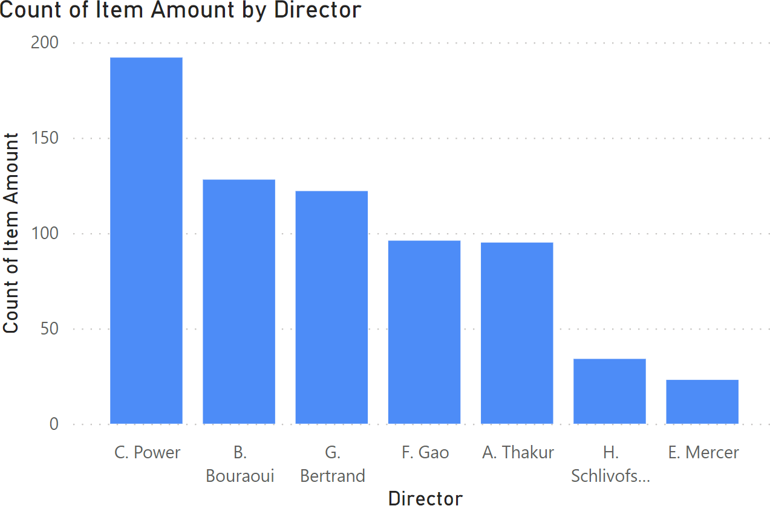
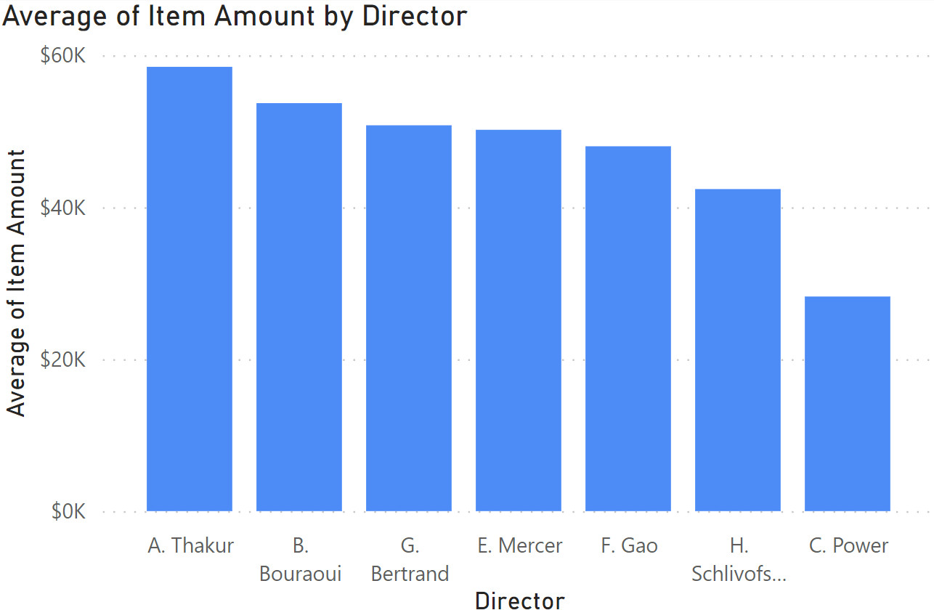
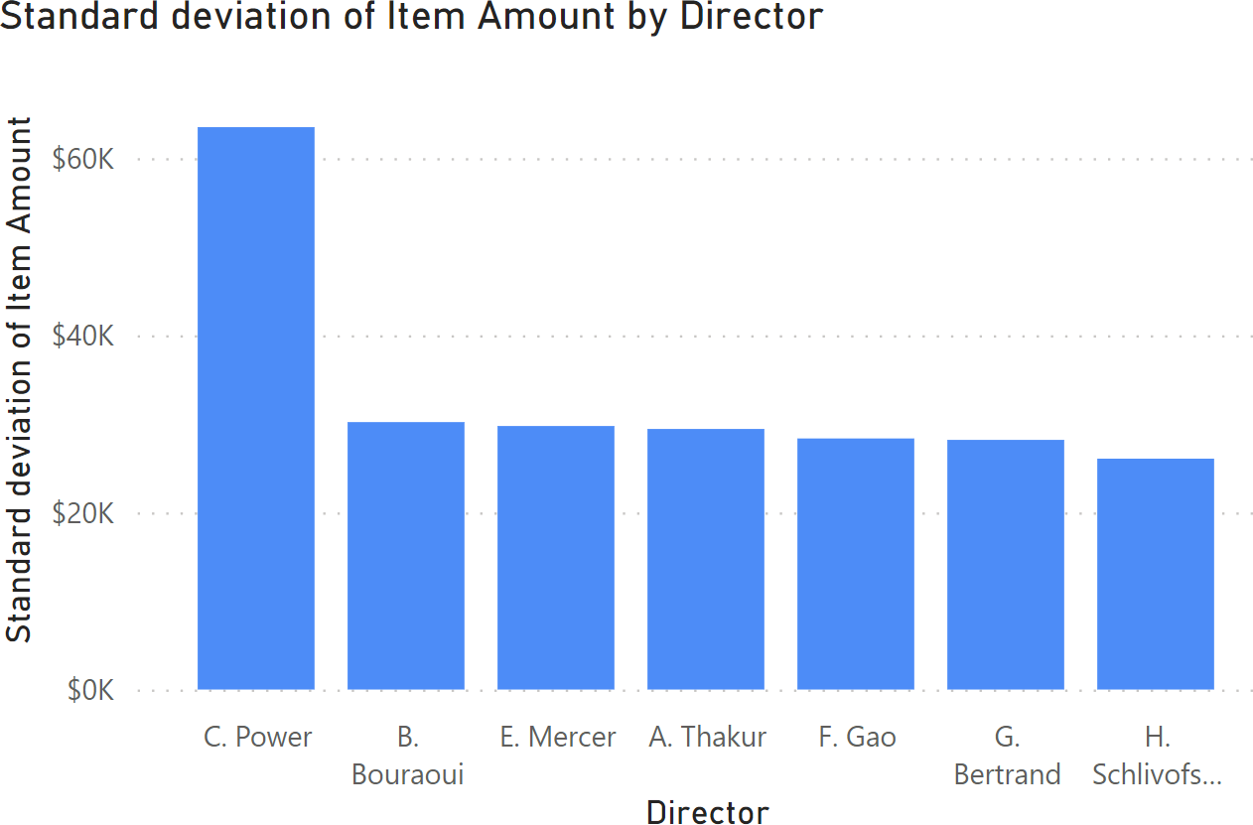
34. Make and Format Column Charts (ID)
We can compute various statistics for each of the directors: # transactions, average/standard deviation of “Item Amount”, etc. (see detailed instructions, pp. 4-5). Note that C. Power has outlying behaviour.

Slide 77
35. Load a PBIX File (PA)
Load and explore PBIFB – 6.pbix (tasks 1-5, 8-10, 12-15, 17-22, 27-29, 31-32, 34).
Go to “Transform Data” in the “Home” Ribbon.
Click on “Data Source Settings”.
Highlight one of the data files.
Click on “Change Source”.
Click on “Browse” and navigate to the corresponding file’s location on your system.
Repeat for the other file.
Press “Close”.
Apply changes from the yellow warning message.

Slide 78
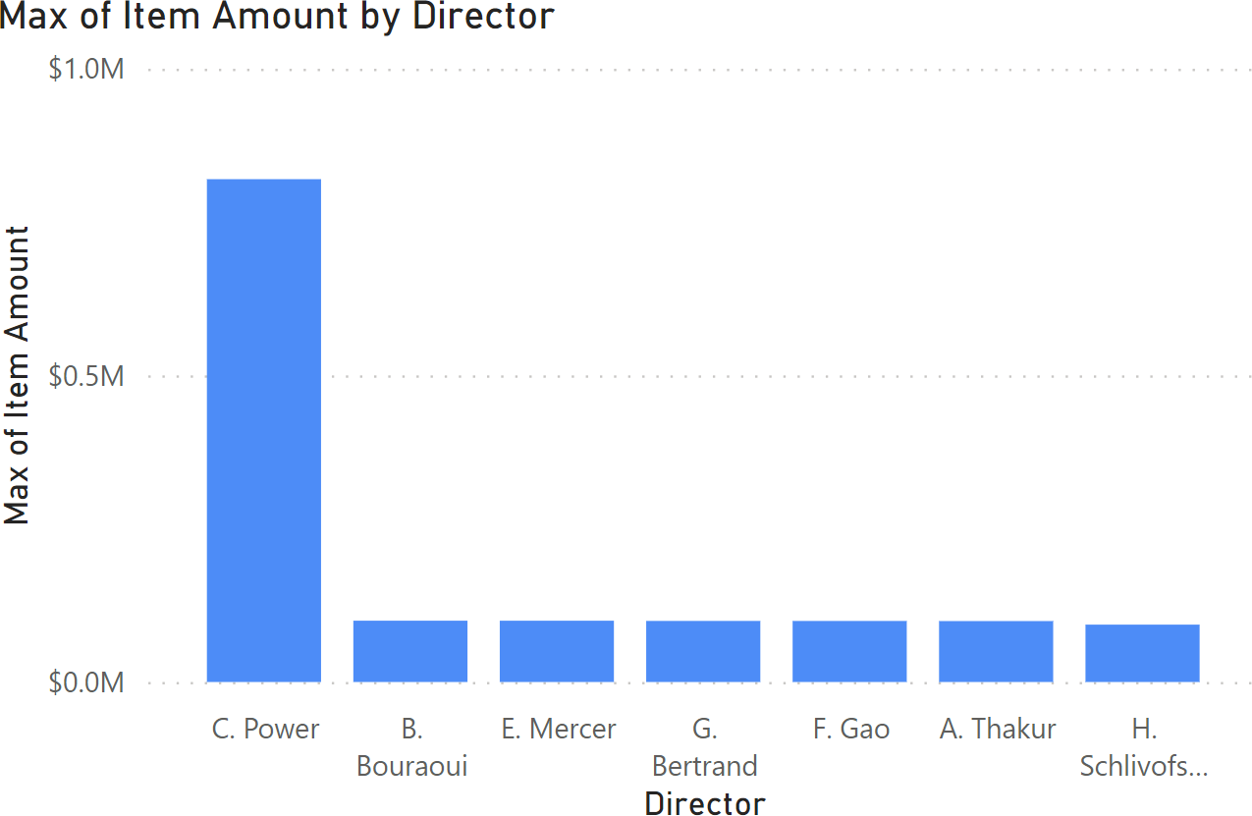
36. Make and Format a Column Chart (PA)
We can compute various statistics for each of the directors: maximum “Item Amount”, in this case (see detailed instructions, p. 5).
Note that C. Power again has outlying behaviour.

Slide 79
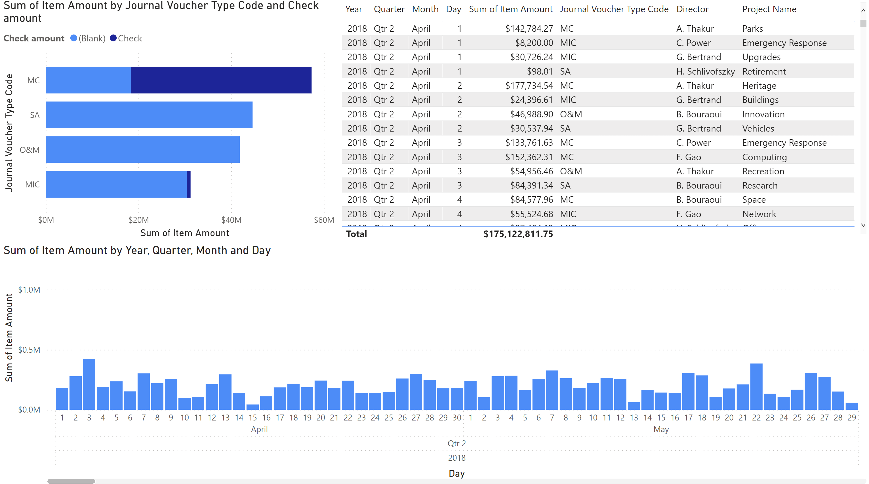
37. Monitoring the Situation (DD)

Slide 80
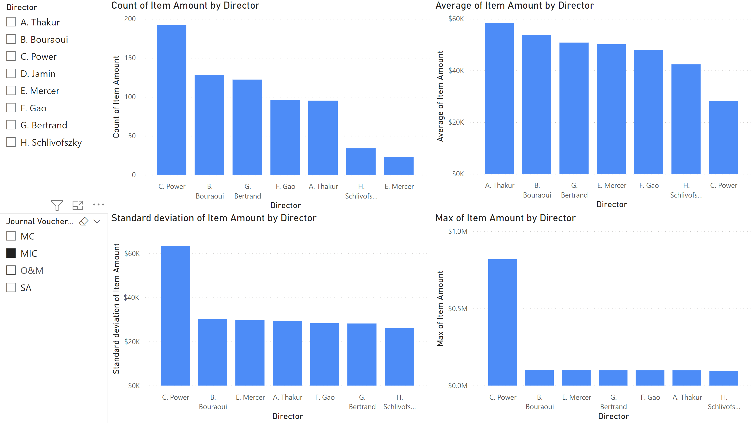
37. Monitoring the Situation (DD)

Slide 81
Exercises
Continue exploring the dashboard. Can you find anything interesting in the data?
Make and format the table of task 28.
Make and format the column chart of task 29.
Create new charts, using calculated measures and columns as necessary, to help you monitor the situation in the dataset.
Situational Awareness
POWER BI FOR BEGINNERS

Slide 82
V. Storybook
Power BI FOR BEGINNERS

Slide 83
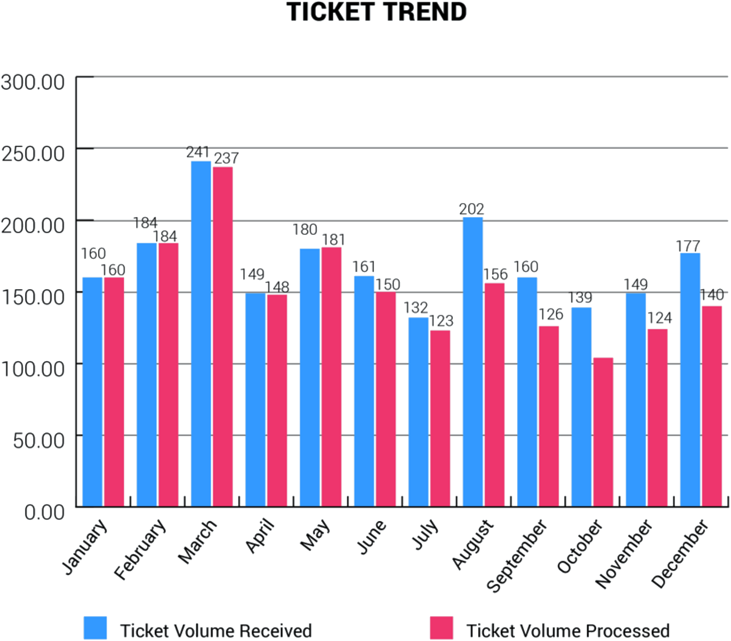
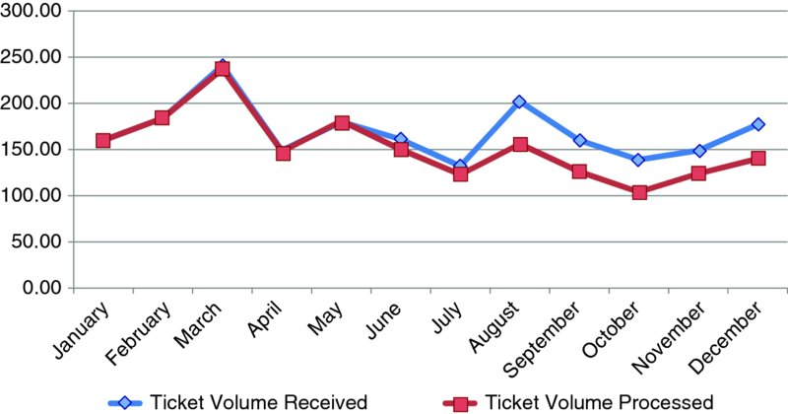
38. Evolving a Chart (BN)
[C. Nussbaumer Knaflic, Storytelling with Data]
1. Change graph type (trope)
POWER BI FOR BEGINNERS

Slide 84
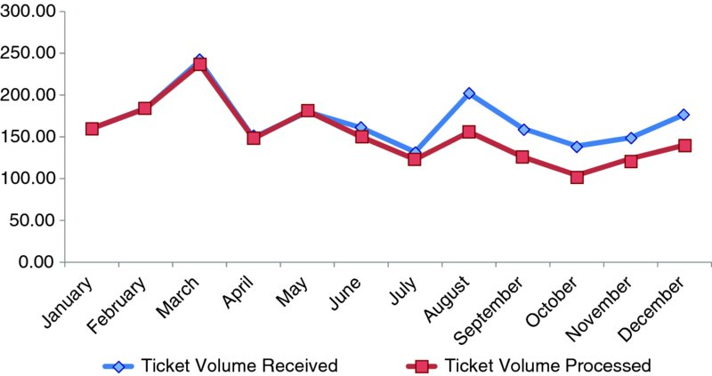
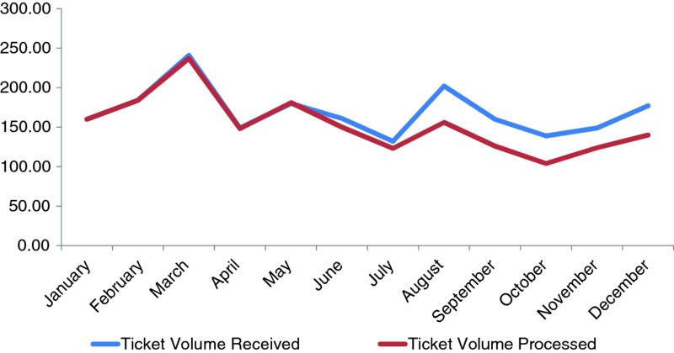
38. Evolving a Chart (BN)
[Based on C. Nussbaumer Knaflic, Storytelling with Data]
2. Remove border and gridlines
3. Remove markers
POWER BI FOR BEGINNERS

Slide 85
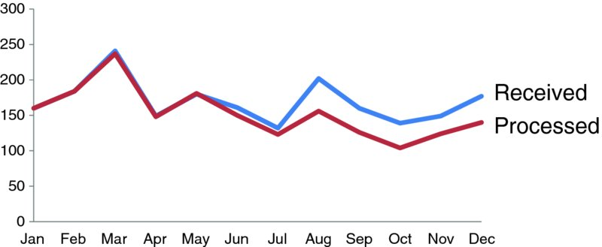
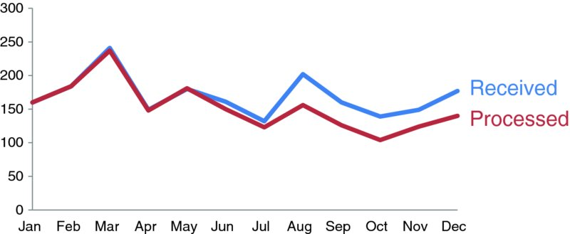
38. Evolving a Chart (BN)
[Based on C. Nussbaumer Knaflic, Storytelling with Data]
4. Clean-up axis labels and legend
5. Colour code the lines
POWER BI FOR BEGINNERS

Slide 86
38. Evolving a Chart (BN)
[Based on C. Nussbaumer Knaflic, Storytelling with Data]
Lag in Tickets Processed Since May Layoffs
6. Tell the story
We have not been able to keep up with tickets received since two employees were let go in May
POWER BI FOR BEGINNERS

Slide 87
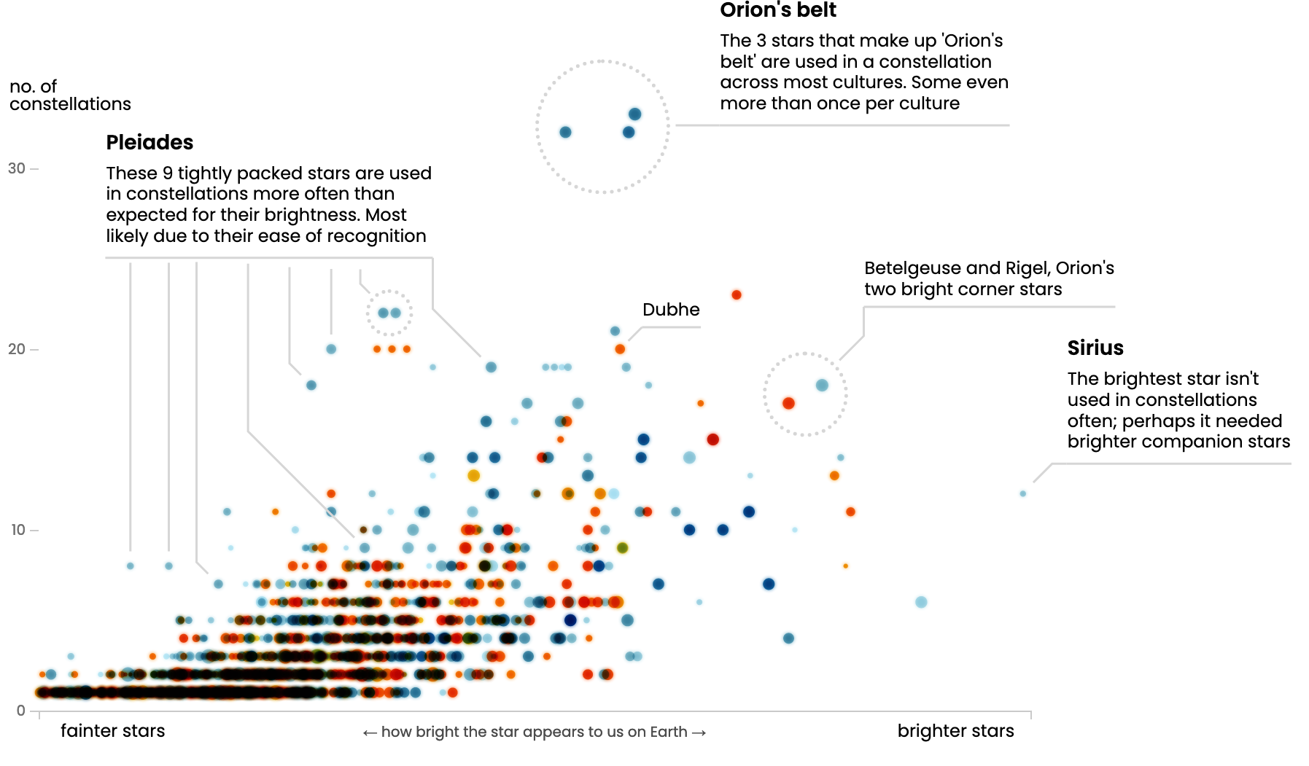
38. Storytelling with Data (BN)
Using visualizations as a tool to explain the data and communicate the story
low level of interactivity
low level of detail
key aspects of data should be represented
annotations and explanations drive the “story”
POWER BI FOR BEGINNERS

Slide 88
39. Create a Calculated Column (ID)
When we were monitoring the situation, we realized that there was a potential issue with C. Power transactions:
gigantic 820,000$ transactions coded as Minor Capital late in the data
small average transaction value
small average standard deviation value
We create a “Power” calculated column (identifying all transactions assigned to this director) to assist with storytelling (see detailed instructions, p. 5).

Slide 89
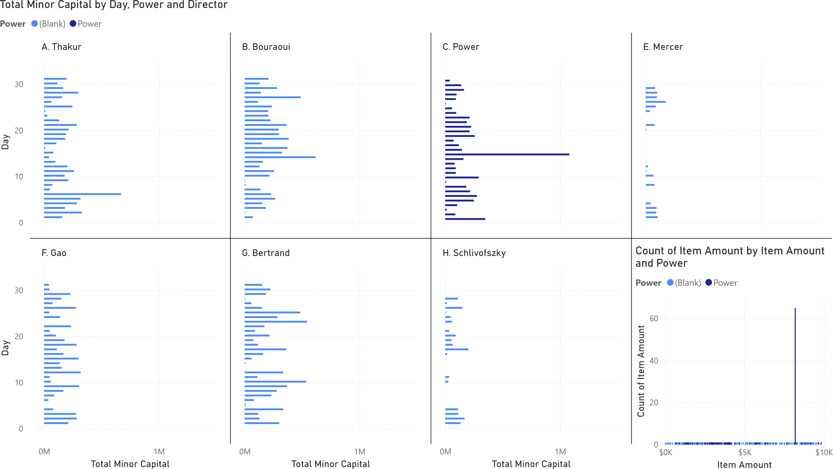
40. Make and Format Small Multiples (ID)
We use this calculated measure to display a bar chart small multiple, displaying the total minor capital for each day of the month, for each director separately, with a different colour for C. Power (see detailed instructions, p. 5).
The profiles for 5 of the 7 directors show high daily transaction volumes, but there is an anomaly!

Slide 90
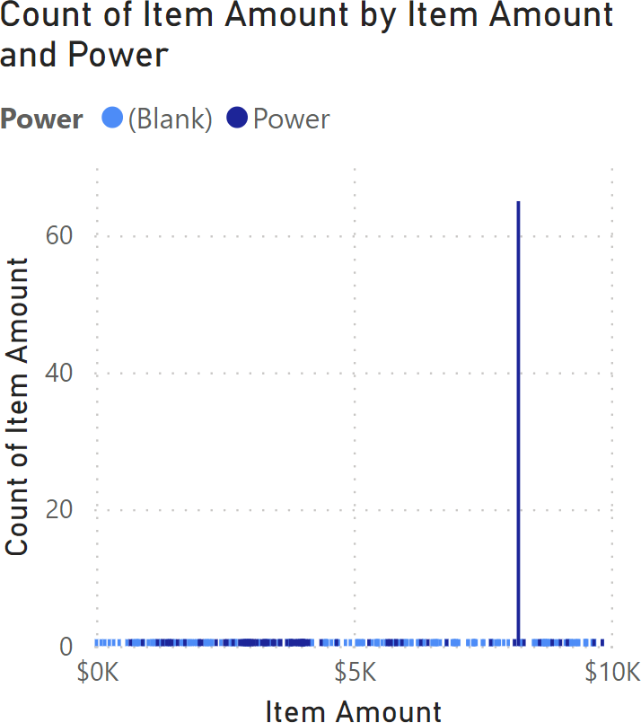
41. Make and Format a Bar Chart (ID)
The last panel is empty; we create a visual that showcases the frequency of individual “Item Amount” values (see detailed instruction, pp. 5-6).
All values are unique, except for 8200$, which appears in 64 transactions by … C. Power – the game is afoot!
(this is easier to spot with a chart filter).

Slide 91
42. Load a PBIX File (PA)
Load and explore PBIFB – 7.pbix (tasks 1-5, 8-10, 12-15, 17-22, 27-29, 31-32, 34, 39-41).
Go to “Transform Data” in the “Home” Ribbon.
Click on “Data Source Settings”.
Highlight one of the data files.
Click on “Change Source”.
Click on “Browse” and navigate to the corresponding file’s location on your system.
Repeat for the other file.
Press “Close”.
Apply changes from the yellow warning message.

Slide 92
43. Apply a Page Filter (PA)
So we have discovered that small Minor Capital transactions (<10,000$) are highly unusual in this dataset.
We apply a page filter to “Storybook 2” so that the corresponding charts are all affected by a 10,000$ “Item Amount” limit (see detailed instructions, p. 6).

Slide 93
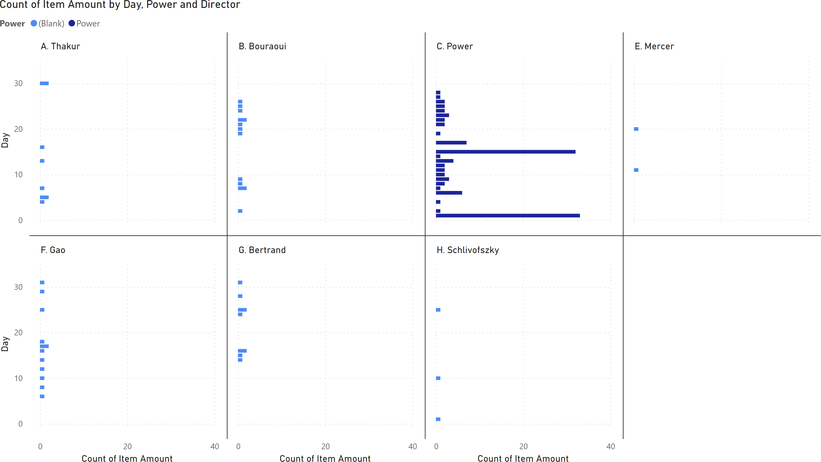
44. Make and Format Small Multiples (PA)
The odd nature of C. Power’s small regime transactions (<10,000$) is clear from the small multiple storytelling bar chart: the unusual transactions take place regularly (1st, 15th of every month) and no other director has even a fraction of the # of small transactions.
Cart him off to jail!
(see detailed instructions, p. 6)

Slide 94
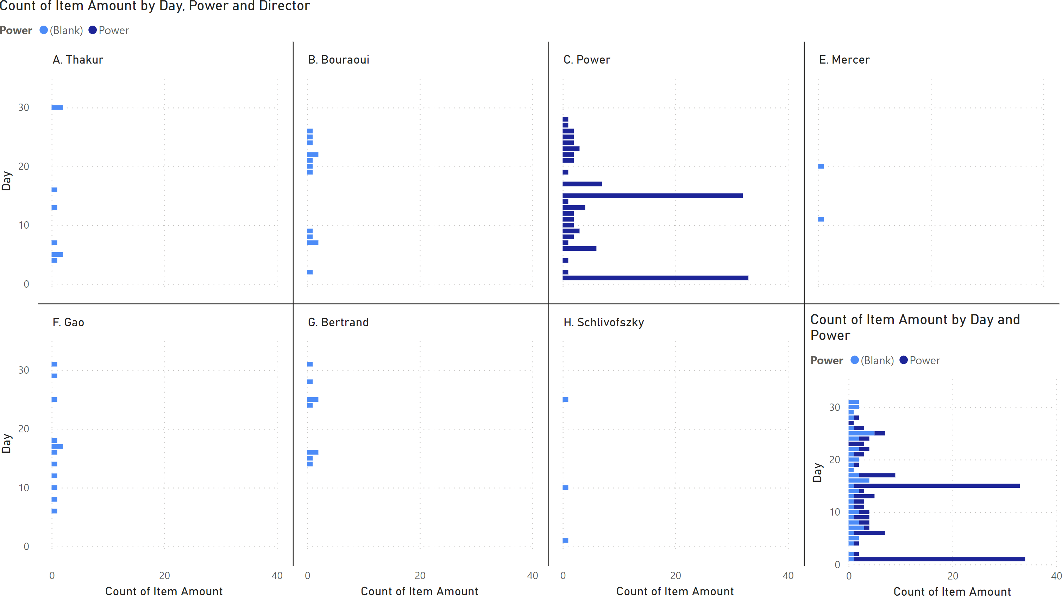
45. Make and Format a Bar Chart (PA)
The last panel is empty; we create a visual that showcases the frequency of daily “Item Amount” transactions, with an emphasis on C. Power’s contribution to the overall profile (see detailed instruction, p. 6).

Slide 95
46. Annotate a Bar Chart (BN)
The best data stories are combinations of text and visuals.
Power BI is not necessarily the greatest tool for that last step (although it can do some of it, it does not do so naturally); don’t hesitate to use other tools as needed.

Slide 96
47. Load a PBIX File (PA)
Load and explore PBIFB – 8.pbix (tasks 1-5, 8-10, 12-15, 17-22, 27-29, 31-32, 34, 39-41, 43-46).
Go to “Transform Data” in the “Home” Ribbon.
Click on “Data Source Settings”.
Highlight one of the data files.
Click on “Change Source”.
Click on “Browse” and navigate to the corresponding file’s location on your system.
Repeat for the other file.
Press “Close”.
Apply changes from the yellow warning message.

Slide 97
48. Convincing an Audience (DD)

Slide 98
48. Convincing an Audience (DD)

Slide 99
Exercises
Annotate the storybooks of tasks 48.
Create new storybooks for the data, and annotate them.
Storybook
POWER BI FOR BEGINNERS

Slide 100
VI. Miscellanea*
Power BI FOR BEGINNERS

Slide 101
49. Publish a Power BI Dashboard (BN)
Once the dashboard is created, it can be “published” it to a website as an iFrame (a webpage inside a webpage).
This allows audiences to fully interact with the dashboard without the need to install Power BI on their computers.
The dashboard can be published publicly, or to pushed to other organization members (individuals with a shared Office 365 and/or Azure environments).

Slide 102
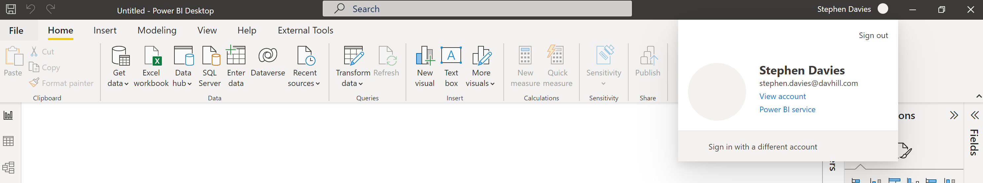
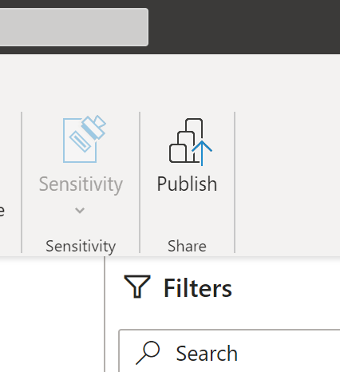
49. Publish a Power BI Dashboard (BN)
This can be done by logging into Power BI using a valid Microsoft credential (the IT department can determine if the regular windows login will work).
After hitting the “Publish” button, Power BI will ask to save the dashboard to a workspace (like an online folder).

Slide 103

49. Publish a Power BI Dashboard (BN)
The next step is login to the online Power BI workspace.
IT Departments can provide guidelines to share the dashboard internally to an organization.
To publish to a public website (disclaimer ALL public links are searchable), the Power BI workspace needs to have this functionality enabled.
Navigate to the dashboard in the workspace, click on “File” and then “Embed Report” and finally “Publish to web (public)”.

Slide 104

49. Publish a Power BI Dashboard (ID)
At this point, the iFrame link can be copied and embedded into the HTML of the website of interest. The end user will then be able to see the (publicly available) dashboard on the website and interact with it as needed.

Slide 105

50. Integrate R in Power BI (BN)
[https://www.sumproduct.com/blog/article/power-bi-tips/power-bi-custom-visuals-box-and-whisker-chart]
The programming languages R and Python can be used for data wrangling and visualizations.* Ensure that you have R downloaded onto your system and point PowerBI at your R installation.
Even beginners may require a visual that is not easily accessible through Power BI. To create an R chart, click on the ‘R’ button under the “Visualizations” panel.
[*Guy in a Cube does a great introductory video.]

Slide 106
References
POWER BI FOR BEGINNERS

Slide 107
References
P. Boily, S. Davies, J. Schellinck, The Practice of Data Visualization. Data Action Lab, 2022.
P. Boily, J. Schellinck, Data Understanding, Data Analysis, and Data Science. Data Action Lab, 2022.
A. Saxton, P. Leblanc. Guy in a Cube. Guy in a Cube, LLC, 2022.
M. Russo, A. Ferrari, D. Perilli. sqlbi. SQLBI, 2022.
N.B. The Microsoft resources found under the help ribbon in PowerBI can also be very helpful. There are links for guided learning, training videos, documentation, support, a blog, and community.

